Slide 1
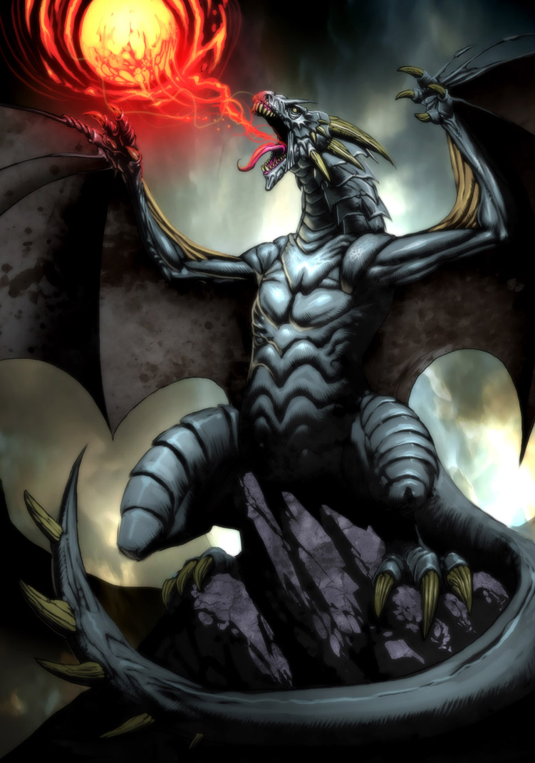
Computer Class
By: Sean Snyder

Slide 2
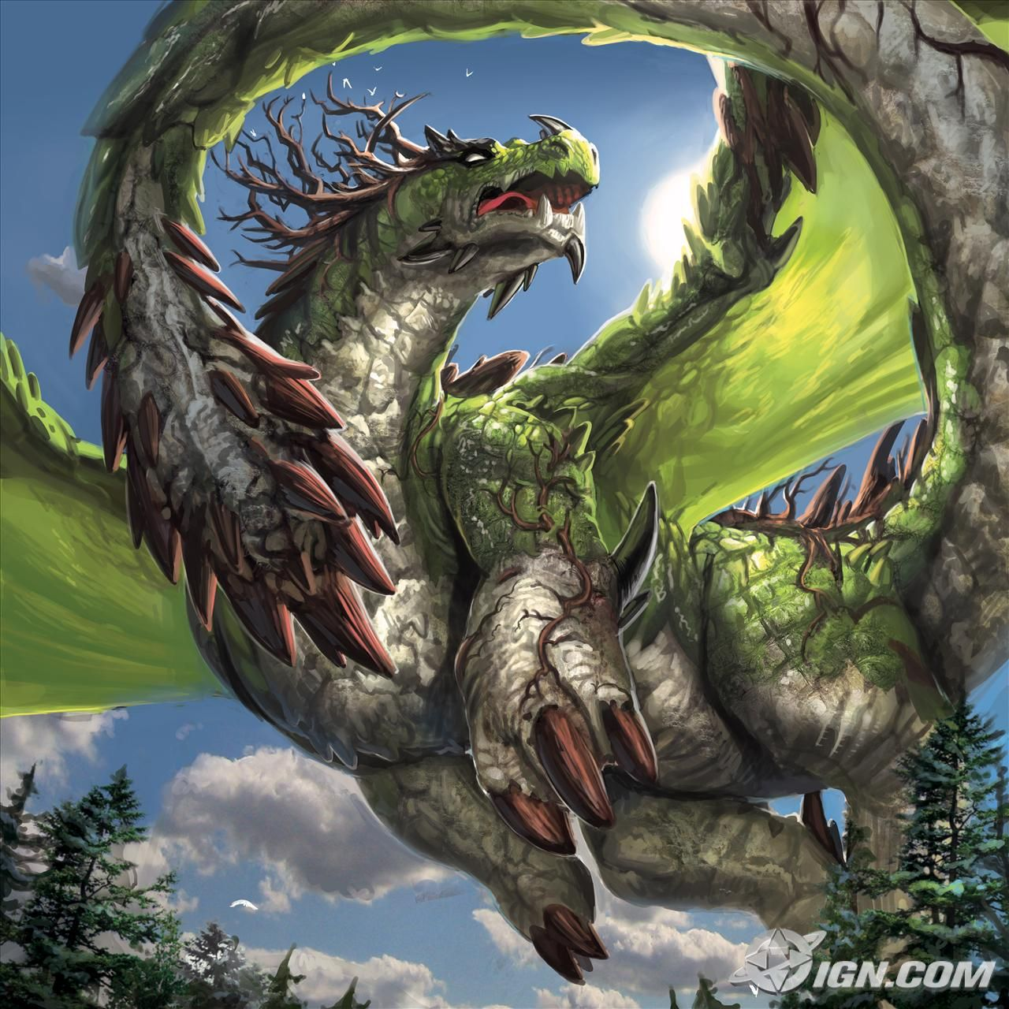
The power point
The power point was my favorite class we made animations , effects , pictures , hyper links, and my favorite part of the power point the pie chart like this.

Slide 3
Random pie chart

Slide 4
This is a hyper link

Slide 5
The video project

Slide 6
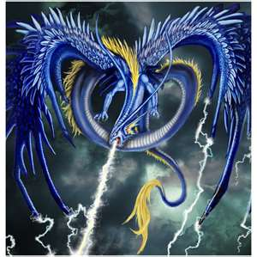
This is about the resume
I hated the resume but , it made every thing more awesome we wrote about fake places we live. how much education we had 5th grade education. We also had to put in special interest and what where good at.

Slide 7
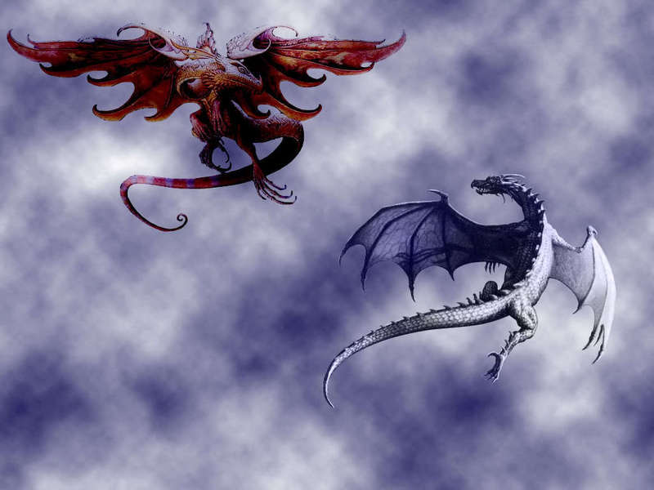
This is my audio track

Slide 8
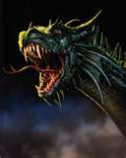
We made magazines
We made magazines (only the cover) my was on dragons. We made little text box that gave you information on what page things where on. Also we could have any pictures we wanted.

Slide 9
Excel page
We made a excel pages on any thing we wanted. First we needed a title. Then I put the years in 2004, 2005, 2006, 2007, 2008, 2009, 2010, 2011. Then I put in the information.

Slide 10
TTTTTTTTTTTTTTHHHHHHHHHHHHHEEEEEEEEEEEEEEEE EEEEEEEEEEENNNNNNNNNNNNNNNNNDDDDDDDDDDDDD

