Slide 1
Unit Two

Slide 2
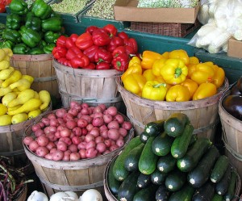
1. Available: ready for use, at hand, obtainable
Unit 2
Adjective
Fresh produce is available at the farmers market.

Slide 3
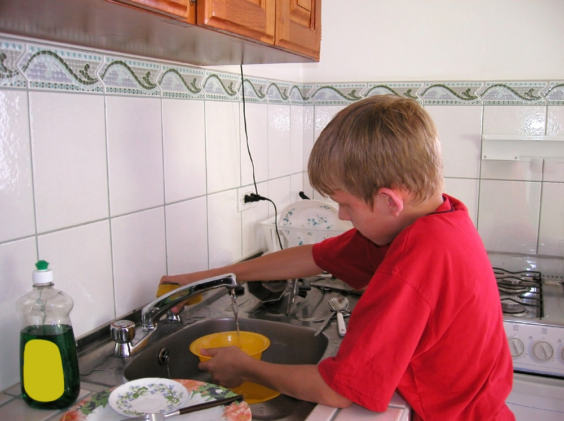
2. Cater: to satisfy the needs of, try to make things easy and pleasant; to supply food and service
Unit 2
Verb
Our grandmother cared for us all summer, but she refused to cater to our every whim, and she expected us to complete chores each day.

Slide 4
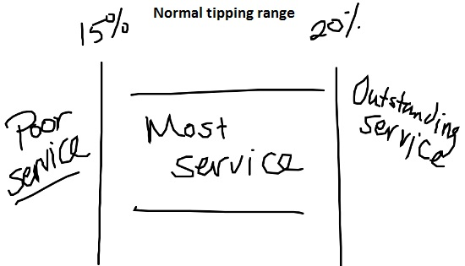
3. Customary: usual, expected, routine, regular, normal, traditional
Unit 2
Adjective
The customary tip given to a waiter for service is 15-20 percent of the bill.

Slide 5
4. Dissuade: to persuade not to do something, discourage
Unit 2
Verb
The great advertising campaign and the information from health class was able to dissuade Chris from smoking.

Slide 6
5. Entrepreneur: a person who starts up and takes on the risk of a business, businessperson
Unit 2
Noun
In the first year of business, an entrepreneur often assumes losses for the sake of future profits.

Slide 7
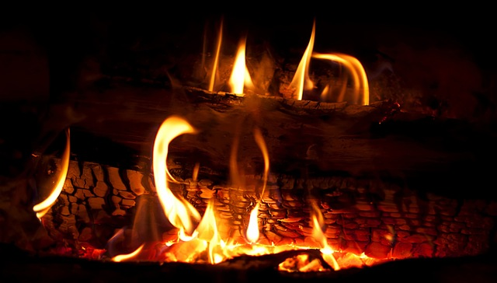
6. Firebrand: a piece of burning wood; a troublemaker; an extremely energetic or emotional person
Unit 2
Noun
The firebrand lasted for hours keeping the friends warm late into the evening.

Slide 8
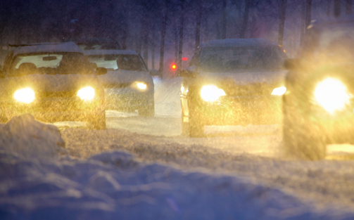
7. Hazard: n. risk, peril, danger; v. to expose to danger or harm; to gamble, venture
Unit 2
Noun
or
Verb
Snow tires can help eliminate the hazard of driving on icy roads. (n.)
When asked to predict when the long drought would end, the meteorologist would not hazard a guess. (v.)

Slide 9
8. Homicide: the killing of one person by another, murder
Unit 2
Noun
It did not take the jury very long to find the defendant guilty of homicide.

Slide 10
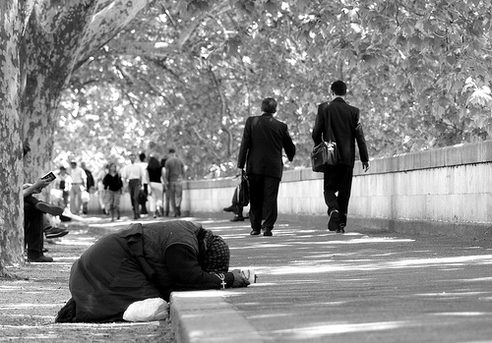
9. Indifference: a lack of interest or concern, apathy
Unit 2
Noun
The fact that everyone walked by, with indifference, the despondent women on the curb is troubling.

Slide 11
10. Indignant: filled with resentment or anger over something unjust, unworthy, or mean, offended, resentful, outraged
Unit 2
Adjective
Angered by the editorial in the newspaper, my mother wrote an indignant letter to the editor.

Slide 12
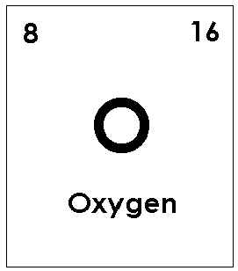
11. Indispensable: absolutely necessary, not to be neglected, essential, crucial, vital
Unit 2
Adjective
Oxygen is a gas that is indispensable to life processes.

Slide 13
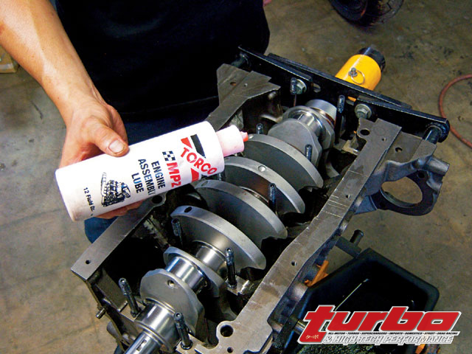
12. Lubricate: to apply oil or grease; to make smooth, slippery, or easier to use, grease
Unit 2
Verb
The workers had to lubricate the equipment regularly so that the engine’s performance would not suffer.

Slide 14
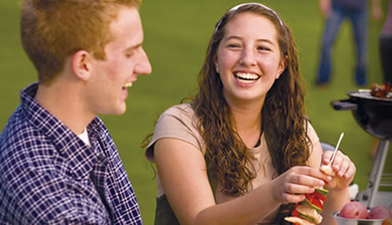
13. Mutual: shared, felt, or shown equally by two or more, joint, shared, reciprocal
Unit 2
Adjective
During the course of the summer, the two teens realized that they had mutual respect and affection for each other.

Slide 15
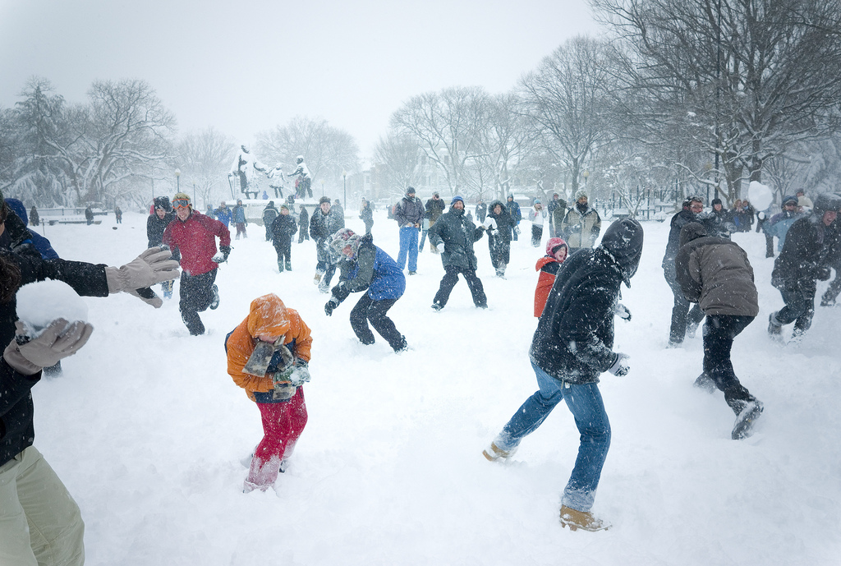
14. Pelt: to throw a stream of things; to strike successively, bombard
Unit 2
Verb
The children resisted the urge to pelt the cars with snowballs and pelted each other instead.

Slide 16
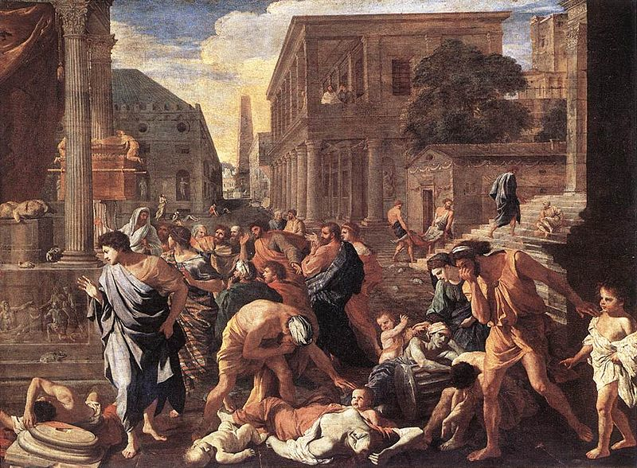
15. Plague: n. an easily spread disease causing a large number of deaths, epidemic; a widespread evil; v. to annoy or bother, pester, vex
Unit 2
Noun
or
Verb
Painting:
“The Plague at Ashdod” by Nicolas Poussin,1630.

Slide 17
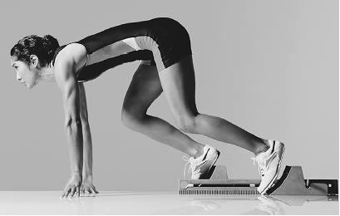
16. Poised: balanced, suspended; calm, controlled, ready for action, collected, self-confident
Unit 2
Adjective Past Participle
A verb form which can be used as an adjective to describe a noun.
The runner was poised to start the race.

Slide 18
17. Regime: a government in power; a form or system of rule or management; administration
Unit 2
Noun

Slide 19
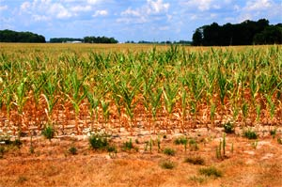
18. Retard: to make slow, delay, hold back, slow down, restrain, impede
Unit 2
Verb
Nothing will retard our crop’s development like another drought.

Slide 20
19. Transparent: allowing light to pass through; easily recognized or understood; easily seen through or detected, clear, translucent, obvious
Unit 2
Adjective
The clients could see easily into the office space through the transparent wall of windows.

Slide 21
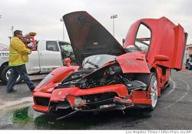
20. Unscathed: wholly unharmed, not injured, unhurt, sound, intact
Unit 2
Adjective
Remarkably, the driver emerged from the wreck unscathed.

