Slide 1
Unit Three

Slide 2
1. Animated: full of life, lively; energetic
Unit 3
Adjective
After seeing the movie, they had an animated discussion about their favorite scenes and characters.

Slide 3
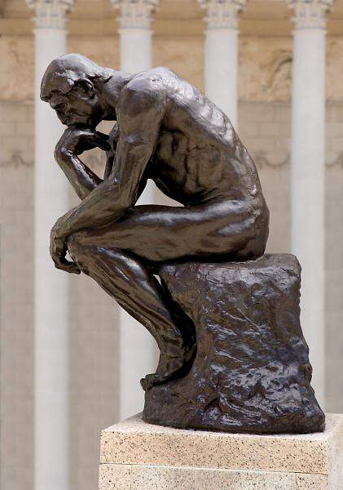
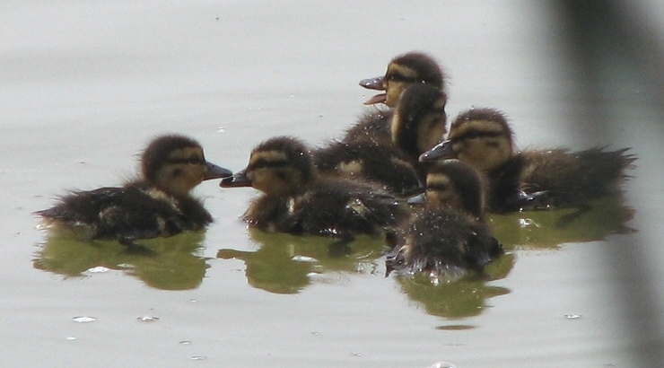
2. Brood: n. a family of young animals, especially birds; any group having the same nature and origin; v. to think over in a worried, unhappy way
Unit 3
Noun
or
Verb
A brood of ducklings.
“The Thinker” by Auguste Rodin was first cast in 1902 and shows a man as he broods.

Slide 4
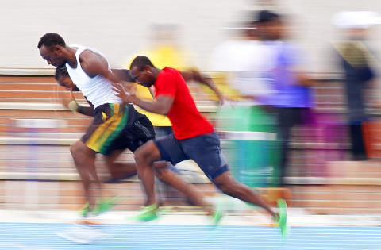
3. Culminate: to reach a high point of development; to end, climax, conclude
Unit 3
Verb
Bolt and his Jamaican teammates hoped that the race would culminate in another win for them.

Slide 5
4. Downright: adv. Thoroughly; adj. absolute, complete; frank, blunt
Unit 3
Adverb
or
Adjective
Our neighbor, who chopped down our tree and destroyed our fence, is just downright mean. (adv.)
The actor felt like a downright fool when he forgot his lines. (adj.)

Slide 6
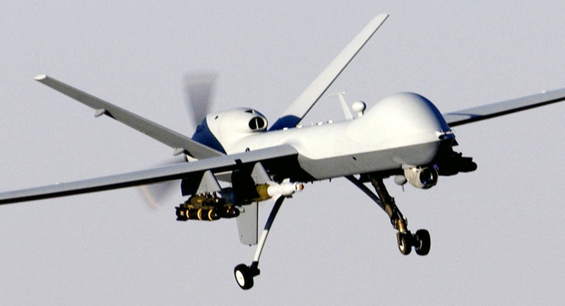
5. Drone: n. a loafer, idler; a buzzing or humming sound; a remote-control device; a male bee; v. to make a buzzing sound; to speak in a dull tone of voice
Unit 3
Noun
or
Verb
The proper use of military and law enforcement drones, is now being debated in our country. (n.)

Slide 7
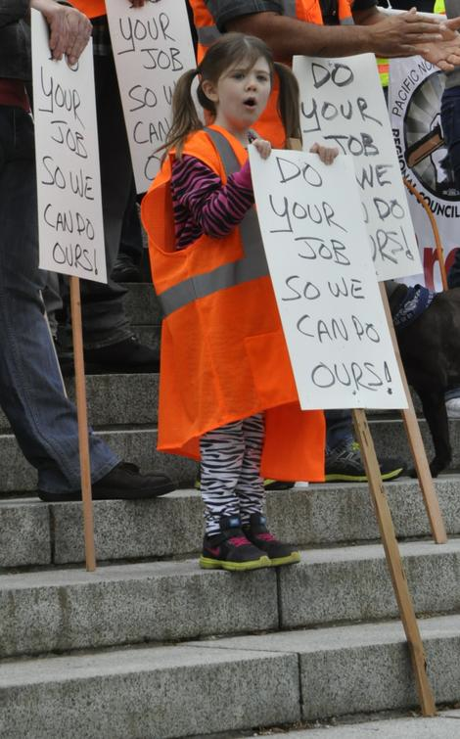
6. Goad: v. to drive or urge on, prod, incite; n. something used to drive or urge on
Unit 3
Verb
or
Noun
Protesters often attempt to goad legislators into approving certain laws and funding. (v.)

Slide 8
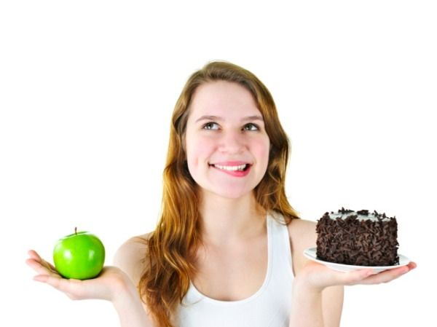
7. Indulge: to give in to a wish or desire, to give oneself up to, oblige, coddle, pamper
Unit 3
Verb
After three Regents exams in one week, the student decided to indulge in a large piece of chocolate cake.

Slide 9
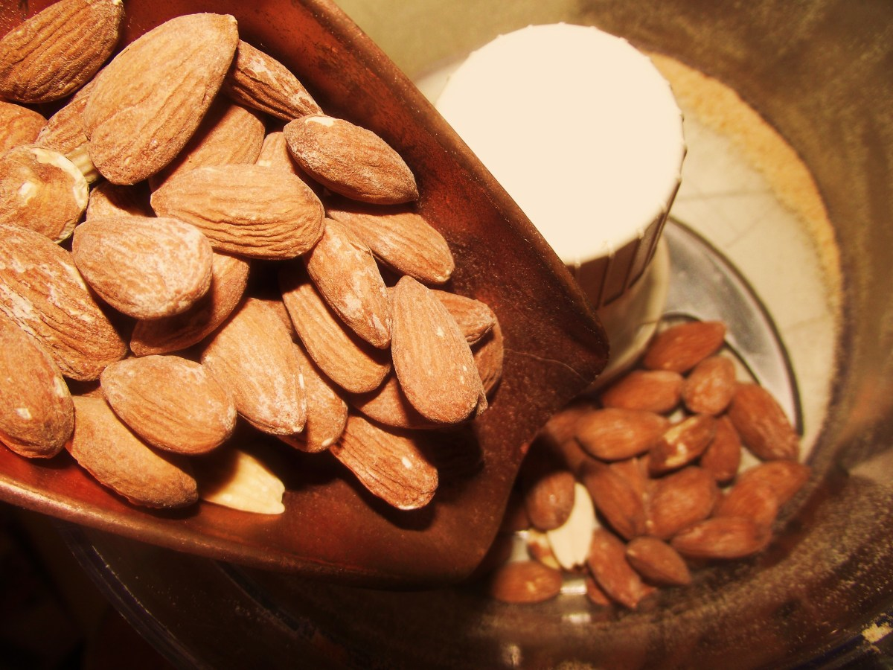
8. Ingredient: one of the materials in a mixture, recipe, or formula, element, component
Unit 3
Noun
Before adding the ingredient to the mixture, I first had to put it through a food processor.

Slide 10
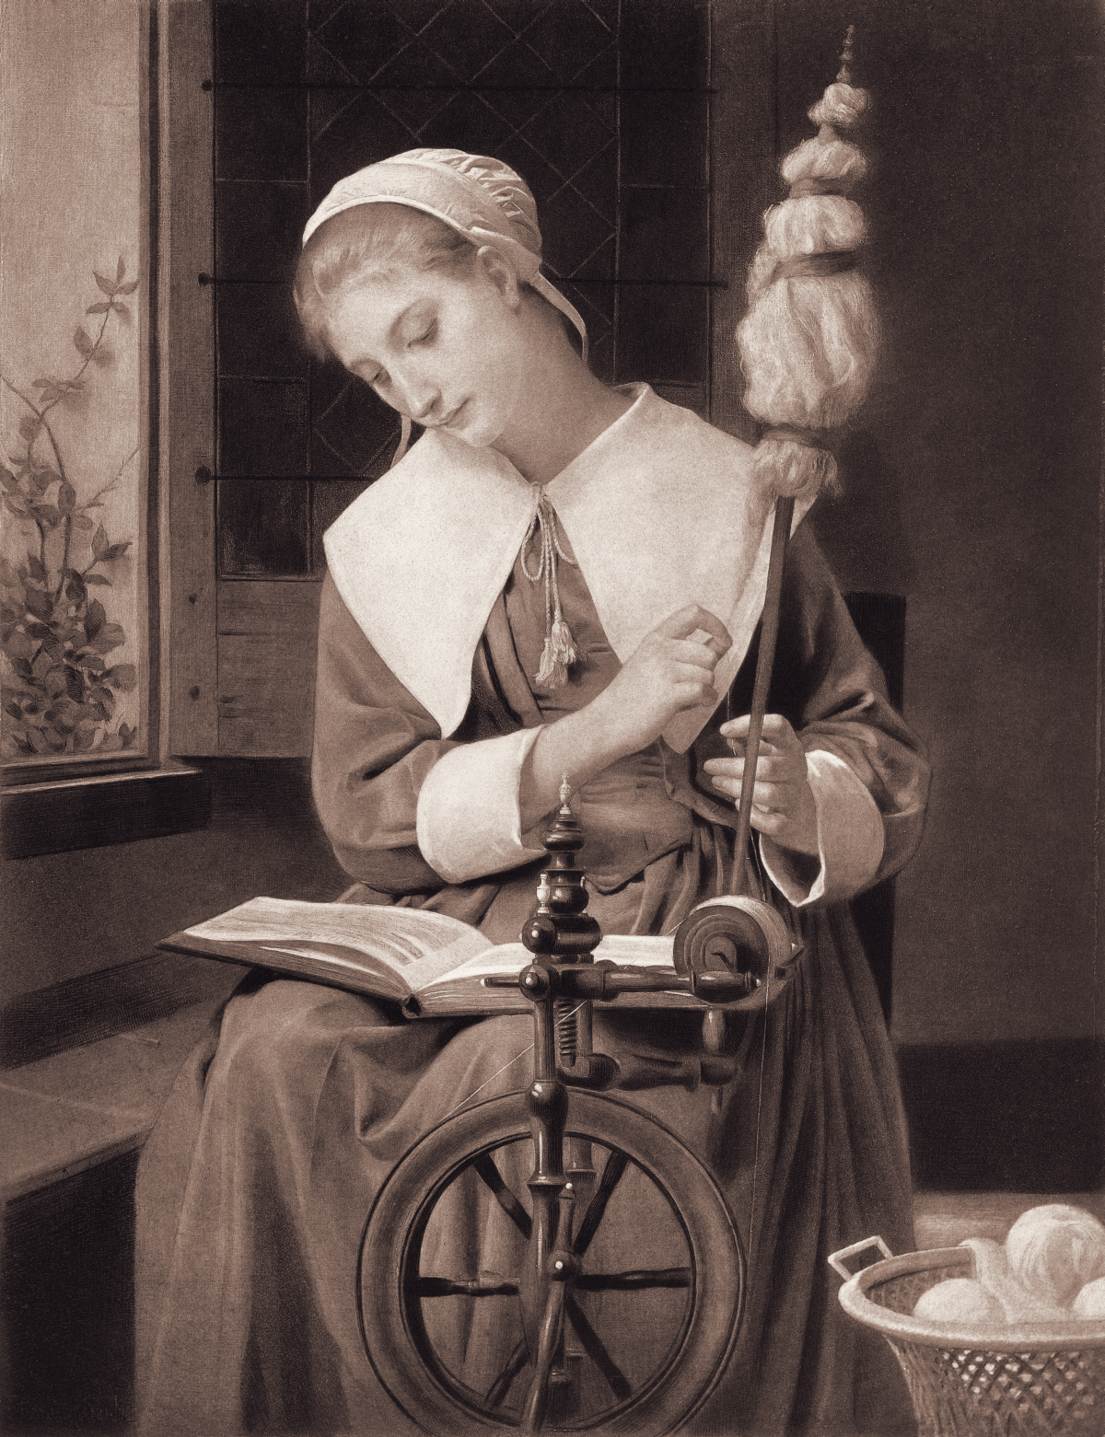
9. Literate: able to read and write; showing an excellent educational background; having knowledge or training, educated, trained
Unit 3
Adjective
Compared with others in the colonial settlement, she was a highly literate young woman.

Slide 11
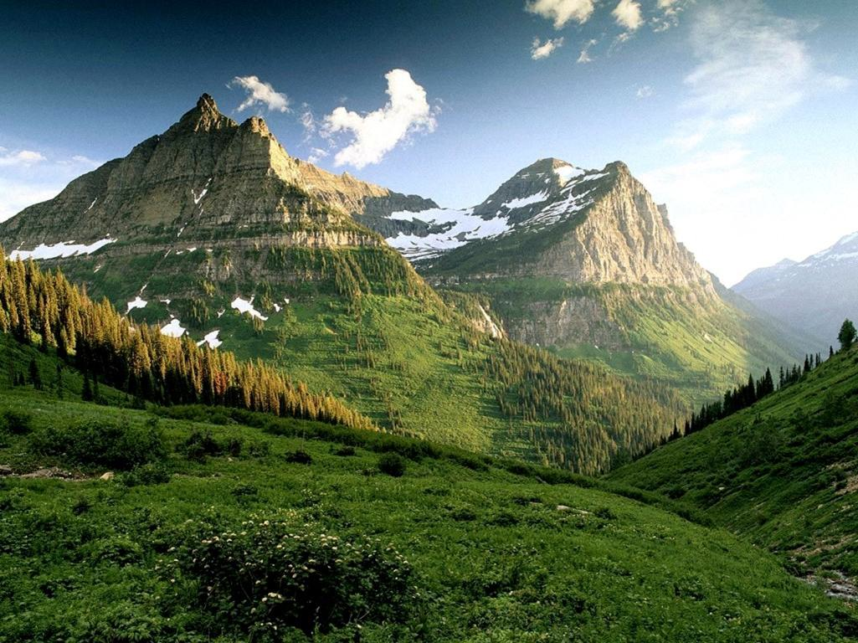
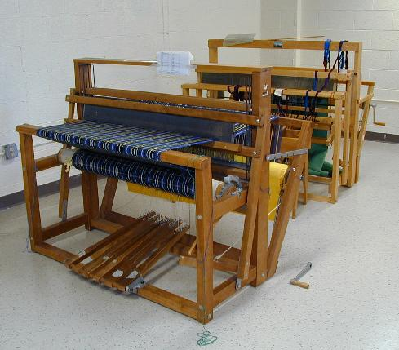
10. Loom: v. to come into view; to appear in exaggerated form; n. a machine for weaving
Unit 3
Verb
or
Noun
Loom
The climbers were awestruck to see the peak loom up before them. (v.)

Slide 12
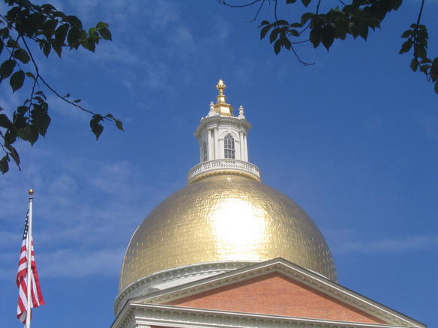
11. Luster: the quality of giving off light, brightness, glitter, brilliance, gloss, sheen, shine
Unit 3
Noun
The polished gold dome atop the state capital shone with a starry luster.

Slide 13
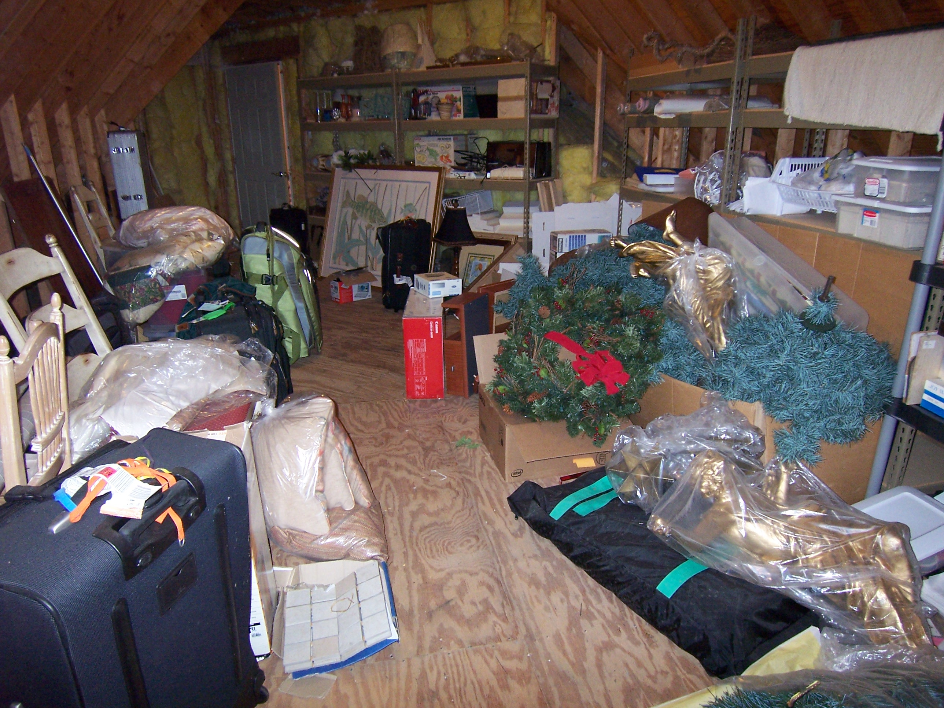
12. Miscellaneous: mixed, of different kinds, varied, assorted
Unit 3
Adjective
A collection of miscellaneous items was gathering dust in the attic.

Slide 14
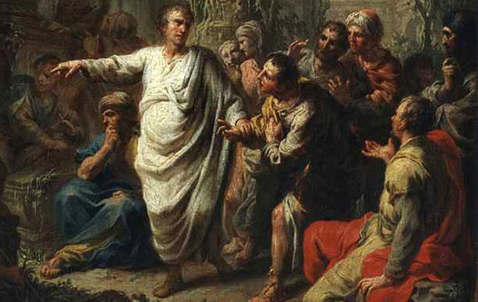
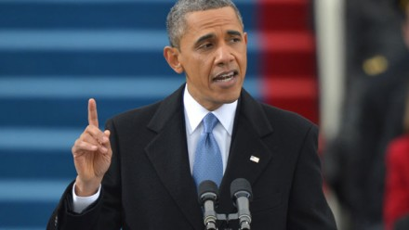
13. Oration: a public speech for a formal occasion, address
Unit 3
Noun
Cicero’s orations in the Roman Senate are still studied by speakers today.
Painting: “Cicero” by Martin Knoller, 1775

Slide 15
14. Peevish: cross, complaining, irritable; contrary, cranky, testy, stubborn
Unit 3
Adjective

Slide 16
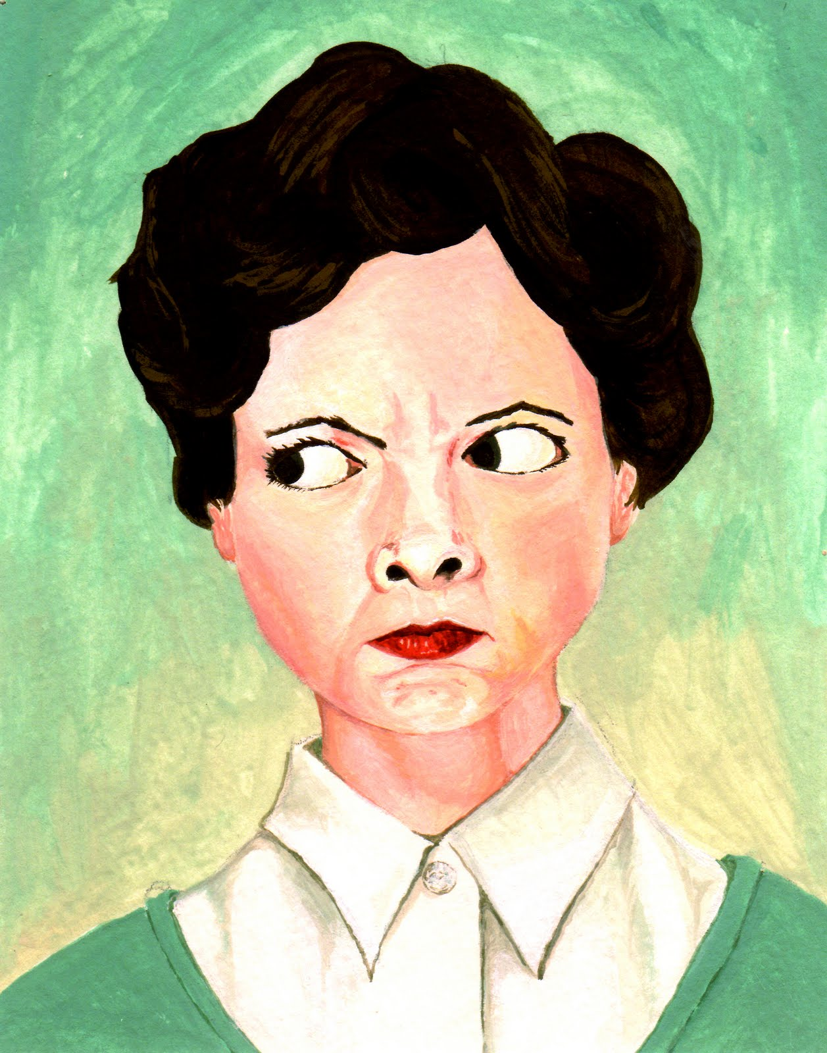
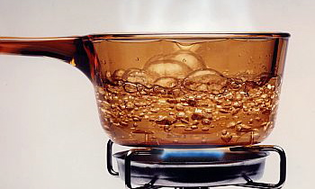
15. Seethe: to boil or foam; to be excited or disturbed; churn, stew
Unit 3
Verb
Seething water.
Mother would seethe with rage each time she learned that a dog had been mistreated.

Slide 17
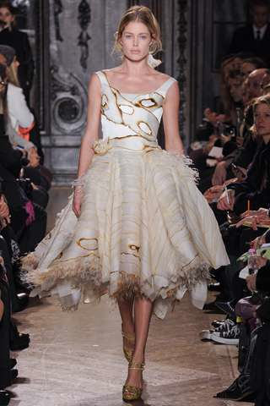
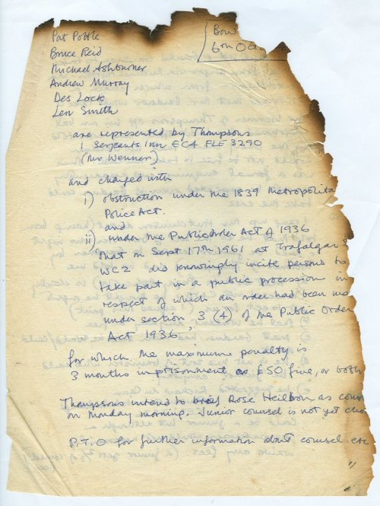
16. Singe: v. to burn slightly; n. a burn at the ends or edges
Unit 3
Verb
or
Noun
Designer Giles Deacon appeared to singe the dresses in his Fall 2012 fashion collection. (v.)
The singe on the document destroyed some of its contents. (n.)

Slide 18
17. Unique: one of a kind; unequaled; unusual; found only in a given class, place, or situation, unparalleled, distinctive
Unit 3
Adjective

Slide 19
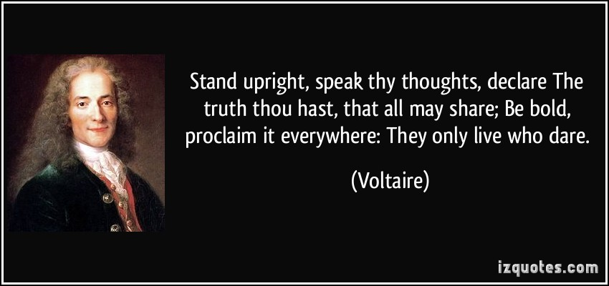
18. Upright: adj. vertical, straight, Perpendicular; good honest, virtuous; adv. in a vertical position
Unit 3
Adjective
or
Adverb
The senator showed her upright character by voting for bills she believed to be morally right. (adj.)
Adverb

Slide 20
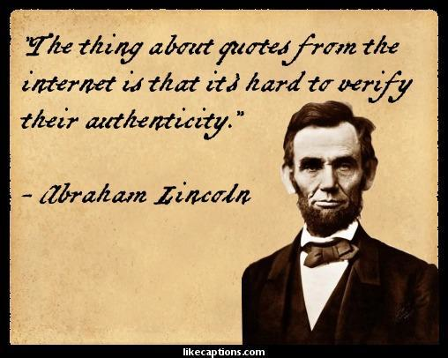
19. Verify: to establish the truth or accuracy of, confirm, prove, validate
Unit 3
Verb
The reporter hurried to verify the source of the controversial statement.

Slide 21
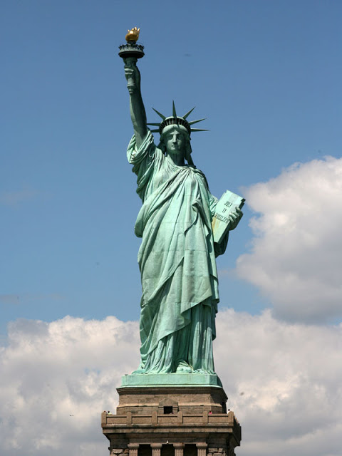
20. Yearn: to have a strong and earnest desire, crave, long for, want
Unit 3
Verb
"Give me your tired, your poor, Your huddled masses yearning to breathe free, The wretched refuse of your teeming shore. Send these, the homeless, tempest-lost to me, I lift my lamp beside the golden door!”
Excerpt from “New Colossus” by Emma Lazarus

