Slide 1
Unit Seven

Slide 2
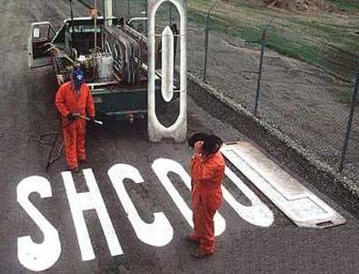
1. Amiss: adj. faulty, imperfect, not as it should be, awry; adv. In a mistaken or improper way, wrongly, awry
Unit 7
Adjective
or
Adverb
The workers realized that something had gone amiss when they looked at what they had painted. (adv.)

Slide 3
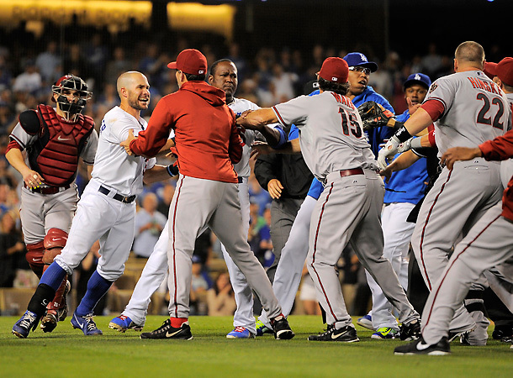
2. Brawl: n. a noisy quarrel or fight, scuffle; v. to quarrel or fight noisily, spar
Unit 7
Noun
or
Verb
After several stray pitches hit batters the players erupted into a brawl. (n.)

Slide 4
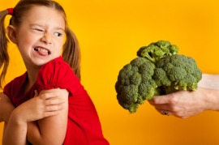
3. Detest: to hate, dislike very much, loathe
Unit 7
Verb
I never understood why so many kids detest broccoli.

Slide 5
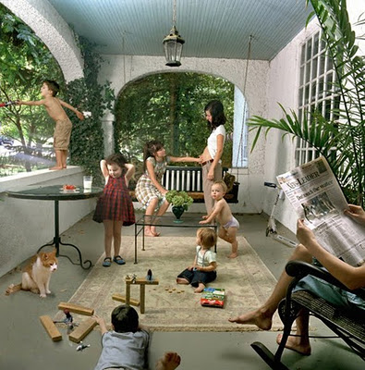
4. Domestic: adj. native to a country, not foreign; relating to the life or affairs of ta household; n. a household servant
Unit 7
Adjective
or
Noun
“The Front Porch” by Julie Blackmon shows a typical domestic moment from the life of a family. (adj.)
When my grandmother first came to this country, she took a hob as a domestic. (n.)

Slide 6
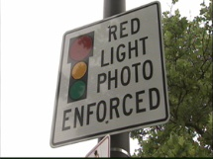
5. Flagrant: extremely bad, glaring; scandalous, notorious, blatant
Unit 7
Adjective
Running a red light shows a flagrant disregard for the law.

Slide 7
6. Flaw: a slight fault, defect, crack, imperfection, blemish
Unit 7
Noun
The flaw in her diamond always made her remember that life wasn’t perfect, but it was pretty darn good.

Slide 8
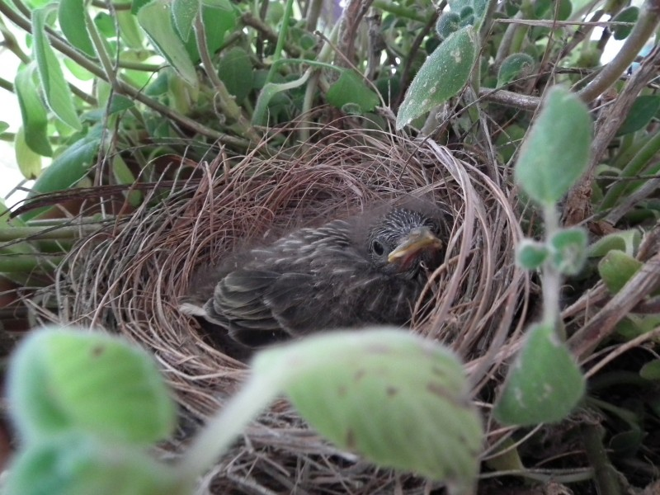
7. Fledgling: n. an inexperienced person, beginner; a young bird about to leave the nest; adj. inexperienced, budding
Unit 7
Noun
or
Adjective
We placed the fledgling back in its nest. (n.)
A fledgling police officer appeared on the scene and wisely called for assistance. (adj.)

Slide 9
8. Fluster: v. to make or become confused, agitated, or nervous; agitate; n. a state of confusion or agitation
Unit 7
Verb
or
Noun
During the trial, the judge told the attorney not to fluster the witness. (v.)

Slide 10
9. Foremost: adj. chief, most important, primary; adv. in the firs place
Unit 7
Adjective
Or
Adverb
Music is foremost among my interests. (adj.)
First and foremost, you must call home to let your family know you’ll be late. (adv.)

Slide 11
10. Momentum: the force or speed with which something moves; drive, thrust, impetus
Unit 7
Noun
The presidential campaign gained momentum once the first primary was over.

Slide 12
11. Notable: adj. striking, remarkable, noteworthy, impressive; n. a person who is well known, distinguished, or outstanding in some way
Unit 7
Adjective
or
Noun
Being chosen for the team was a notable event in our lives. (adj.)
The party was attended by notables from the film world. (n.)

Slide 13
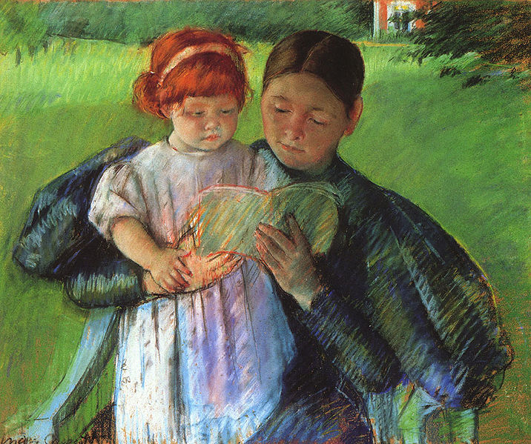
12. Nurture: v. to bring up, care for, train, nourish, raise, rear, foster; n. rearing, training, upbringing
Unit 7
Verb
or
Noun
She was guided by her mother’s nurture from the time she was a small child. (n.)
“Nurse Reading to a Little Girl” by Mary Cassatt, 1895

Slide 14
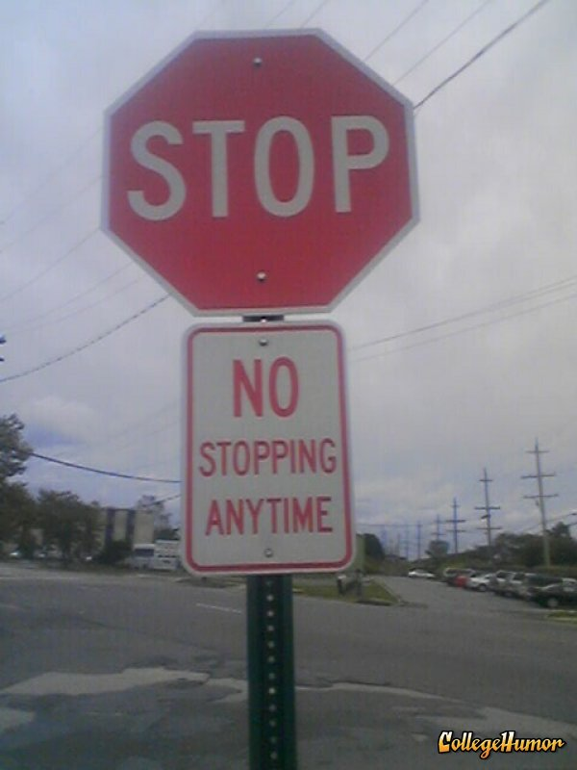
13. Paradox: a self-contradictory statement that on closer examination proves true; a person or thing with seemingly contradictory qualities; riddle, enigma
Unit 7
Noun
It is a paradox to say that youth is wasted on the young.

Slide 15
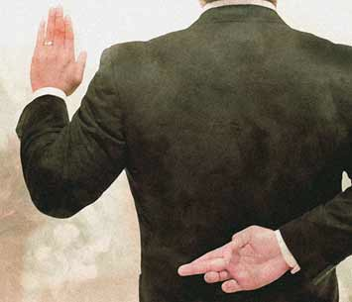
14. Perjury: the act of swearing to a lie, false witness
Unit 7
Noun
The witness was convicted of perjury and was sentenced to serve two years in prison.

Slide 16
15. Presume: to take for granted, assume or suppose; take liberties
Unit 7
Verb
To offer a man unsolicited advice is to presume that he doesn't know what to do or that he can't do it on his own.
—John Gray

Slide 17
16. Prior: earlier, former, previous
Unit 7
Adjective
Unfortunately the governor had a prior appointment and could not meet with the class.

Slide 18
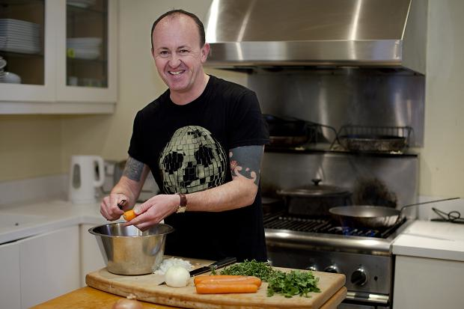
17. Proficient: skilled, expert, or capable in any field or activity, competent, adept, able
Unit 7
Adjective
Dad knows his way around the kitchen and is quite a proficient cook.

Slide 19
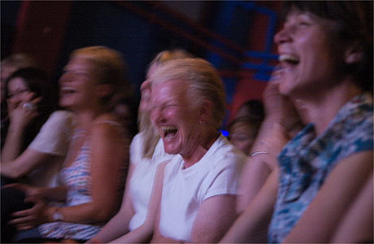
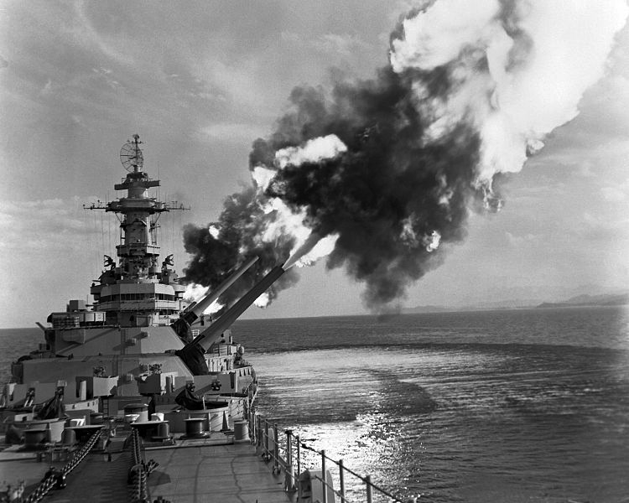
18. Salvo: a burst of gunfire or cannon shot, often as a tribute or salute; a sudden burst of anything; a spirited verbal attack
Unit 7
Noun
The audience erupted in a salvo of laughter.
USS New Jersey fires a nine gun salvo in 1953.

Slide 20
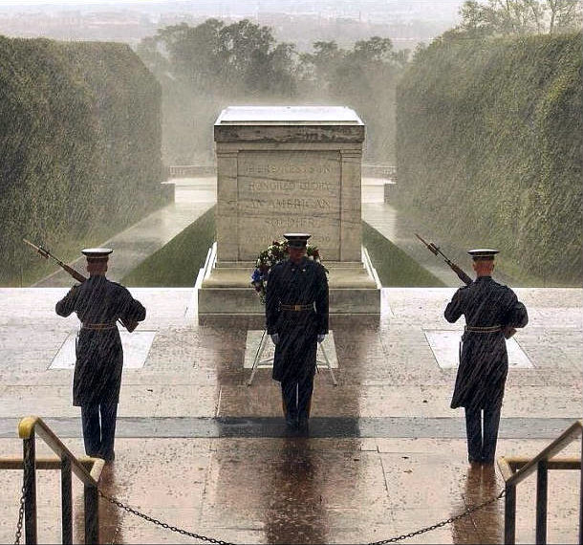
19. Vigilant: wide-awake, alert, watchful, attentive, on one’s toes
Unit 7
Adjective
The vigilant guards paced back and forth in front of the tomb of the unknown soldier.

Slide 21
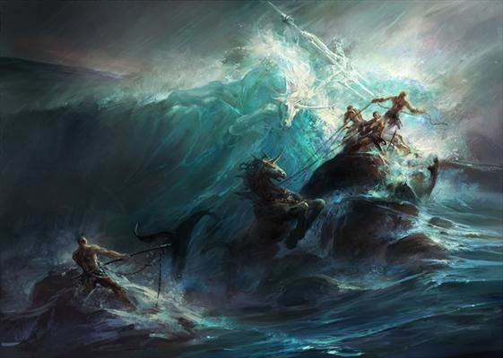
20. Wrath: intense anger, rage, fury, ire, indignation
Unit 7
Noun
In Greek and Roman myths characters fear the wrath of the gods.
“Poseidon’s Wrath” by Dehong He

