Slide 1
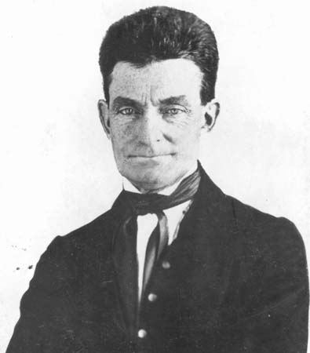
Objectives:
To explain the causes of the Civil War.

Slide 2
Bellringer QUIZ!!!!
1. What term means that the people of the state decide the slave status of the state?
2. What was the secret network of conductors that hid and transported runaway slaves to the North?
3. What piece of literature increased northern awareness of the plight of slaves' lives (written by Harriet Beecher Stowe)?
4. What piece of legislation inspired many pro and anti slavery extremists to move west?
5. What event occurred when John Brown retaliated for the attacks on Lawrence, Kansas?

Slide 3
10.1
Wilmot Proviso:
What were the 5 parts of the Compromise of 1850?

Slide 4
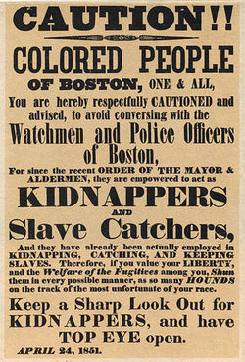
What part of the Compromise of 1850 were the Northerners most upset with?

Slide 5
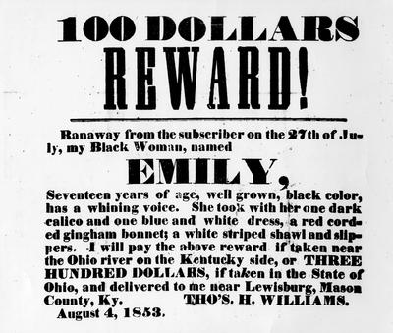
Road to War
1. Fugitive Slave Act (1850)
a. if caught aiding a fugitive slave you would be fined or jailed
b. infuriated Northern abolitionists

Slide 6
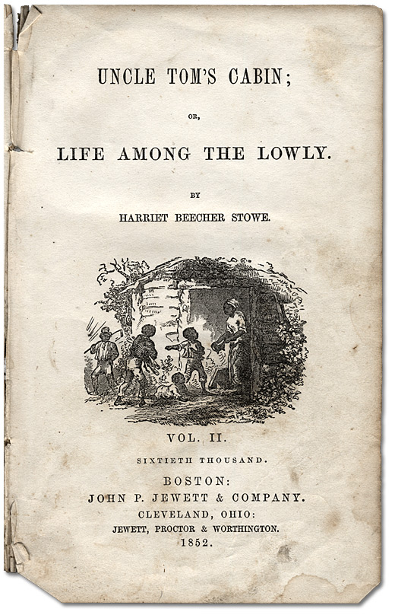
2. Uncle Tom's Cabin (1852)
a. Harriet Beecher Stowe
b. effects
1.) increase in support for abolitionists
2.) southern plantation owners infuriated

Slide 7
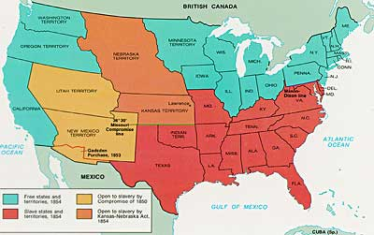
3. Kansas Nebraska Act (1854)
a. popular sovereignty determined slave status of states
b. both abolitionists (Emigrant Aid Society) and proslavery forces move to Kansas to vote
c. repealed Missouri Compromise

Slide 8
4. Formation of the Republican Party (1854)
a. antislavery Whigs and Free Soilers (Dem)
b. opposed spread of slavery to new territories

Slide 9
5. "Bleeding Kansas" 1856
a. 2 governments in Kansas (illegal votes from MO vote in a proslavery legislature - the Free Soilers have refused to accept it and formed their own legislature)
b. MO proslavery forces attacked abolitionists in Lawrence, Kansas
c. John Brown leads abolitionists' retaliation
d. Pottawatomie Massacre
e. foreshadowing

Slide 10
Closure - Uncle Tom's Cabin

