Slide 1
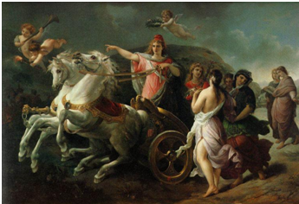
Puritanism in America

Slide 2
Some Quotes:
Bound together, they [the Puritans] established a community that maintained a healthy economy, established a school system, and focused an efficient eye on political concerns. The moral character of England and America were shaped in part by the words and actions of this strong group of Christian believers called the Puritans. [Puritans: http://www.nd.edu/~rbarger/www7/puritans.html]

Slide 3
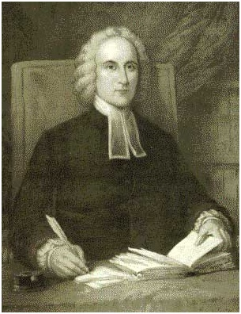
The Puritans either participated in or led the charges that transformed the political climate of England and North America (and thereby the world). They wrote poetry, fiction, and theology prolifically and still claim two of the most widely read English texts ever written–Paradise Lost and Pilgrim’s Progress. In the early 1700′s Jonathan Edwards stood at the helm of the first great awakening, during which enormous spiritual transformation swept across America (and even England, with fiery speakers like George Whitfield).
[http://veritasmizzou.wordpress.com/2010/03/24/whypuritansinsultus/]

Slide 4
The Puritans succeeded in bursting the bonds of mere religiosity in their efforts to serve God. Puritanism was one of the moving forces in the rise of the English Parliament in the early seventeenth century. For good and for ill, it provided a foundation for the first great political revolution in modern times. It gave immigrants to Massachusetts a social vision whose comprehensively Christian character has never been matched in America. And, for such a putatively uncreative movement, it liberated vast energies in literature as well. [Puritanism, Puritans: http://mb-soft.com/believe/txc/puritani.htm]

Slide 5
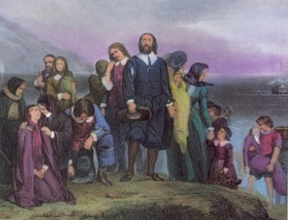
Not This
But this

Slide 6
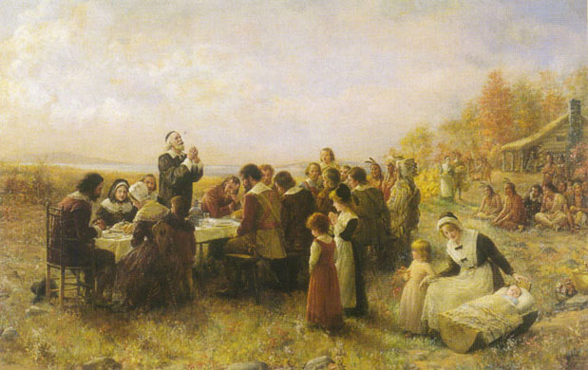
and this…

Slide 7
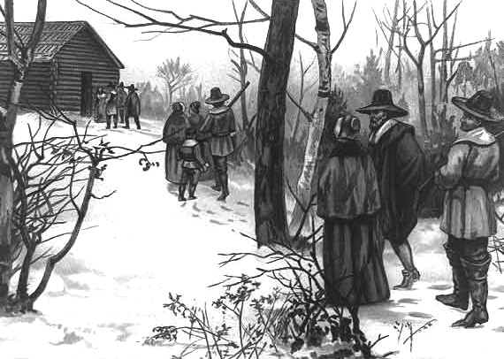
and this…

Slide 8
but this, too…

Slide 9
and this…

Slide 10
Early history (in England)
"We must picture these Puritans as the very opposite of those who bear that name today: as young, fierce, progressive intellectuals, very fashionable and up-to-date. They were not teetotalers; bishops, not beer, were their special aversion..." C. S. Lewis
Their worldview is perhaps best summarized in the first answer in the Westminster Shorter Catechism: "Man's chief end is to glorify God and enjoy him forever."

Slide 11
There were two groups of Puritans: those who wanted to reform the Church of England from within [reformers] and those who believed the church was too far gone to reform and wanted to start a new church [separatists].
Most of the New England Puritans were separatists

Slide 12
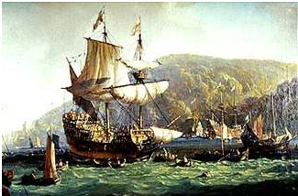
Timeline
1603: Elizabeth I dies; James I becomes King
1620: First settlement in New England – Plymouth Bay Colony
1630-1641: “Eleven years of Tyranny”
1640: 17,800 immigrants to the colonies
1642-1651: English Civil War
1649: King Charles I beheaded
1658: Oliver Cromwell’s death
1660: King Charles II becomes King of England

Slide 13
Later History (America)
Most immigrants to the NE colonies weren’t Puritan, but most of the leaders were.
Puritans settled not only in NE (early 1600’s – primarily Congregational) but also in NY, NJ and PA (late 1600’s and the 1700’s - Presbyterian)

Slide 14
Beliefs
Overarching: The Bible will tell me what I need to know and what I need to do to live
God is in charge (of everything)
Man isn’t good; not by a long shot
If man is to have a good relationship with God, God has to do it
Each person is responsible for his own relationship with God; for his own spiritual condition

Slide 15
and… “Our way or the highway”
Women: relative social equality (with the exception of church leadership)
Children: born sinful, and raising them meant breaking their will until they were able to sublimate their own desires to those of the family and community
Elders (men): viewed as cherished saints, entitled by their wisdom to govern
Education:
Banned: drama, religious music and erotic poetry. Encouraged: Bible, Greek classics, poetry and Latin verse. They were encouraged to create their own poetry, always religious in content.
Free schooling was offered for all children. Reading was emphasized. "Ciphering" (math) and writing were emphasized less
Rights: Individuals could only have privileges. Rights belonged to institutions and governments -- and chief among them was the right of the institution to do what it must to maintain civil order and see to it that people met their responsibilities.
Bible: The Puritans believed that the Bible was God's true law, and that it provided a plan for living.

Slide 16
Notable dissidents:
Roger Williams: Williams was convinced that the control of civil law and the church should be separated – the government should not be passing or enforcing laws that deal with religion. He was, at least for a time, a Baptist. Ultimately he was exiled from Massachusetts and eventually founded Rhode Island where the concept of “Freedom of Religion” was born.
Anne Hutchinson

Slide 17
Daily Life
Children would be expected to help their parents as soon as they were old enough. They might learn to read and write at home, or they might attend a ‘dame school’ which taught simple reading, writing and arithmetic. Older boys might go to a grammar school, but many children would leave school early to go to work, either to work in the family farm or business, or to be apprenticed to a trade. Girls often worked as servants until they married, or they might be apprenticed for a trade: dressmaking, millinery, and some other trades like printing.

Slide 18
Daily Life, cont.
The most prestigious occupation for men was minister or doctor
The most prestigious “occupation” for girls was housewife or midwife

Slide 19
Values
Desire to establish God’s Kingdom on Earth
Willingness to get their hands dirty
“We” not “me” perspective
“We can do it” attitude

