Slide 1
Life and Times of a Puritan Teenager

Slide 2
What’s a Puritan?
Had a problem with the church in England (late 1500’s - think Shakespeare)
Wanted the church to be more “pure” They felt the Church leadership (bishops) were too greedy and not spiritual enough.
Two ways to deal with the problem:
1. Change the church
2. Leave the church

Slide 3
What happened?
The government (Queens and Kings) sometimes listened to the Puritans but most of the time they didn’t.
Eventually the Puritans ended up in two groups:
1. Reformers: stayed in the Church of England and tried to “fix” it from within
2. Separatists: wanted out of the church and to form their own church

Slide 4
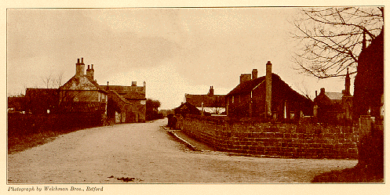
The village of Scrooby, England,
home to the Puritans until 1607

Slide 5
And then?
Church and government officials started persecuting the Puritans for not supporting the Church – fining them, putting them in prison, and even killing some of them.

Slide 6
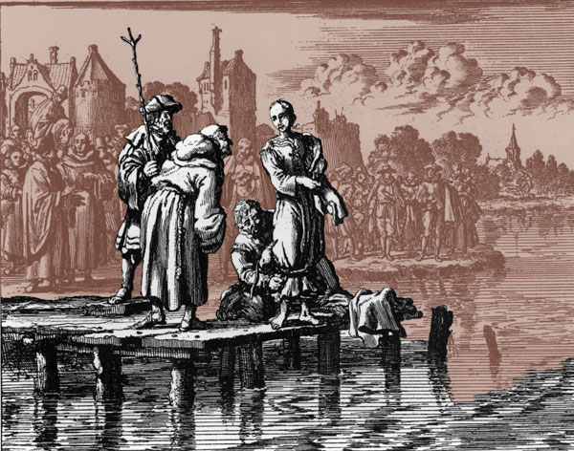
And then?
Church and government officials started persecuting the Puritans for not supporting the Church – fining them, putting them in prison, and even killing some of them.
So… the Puritans started leaving England – some went to the New World. The first Puritans ended up in what is now Massachusetts - The Plymouth Bay Colony

Slide 7
From England to New England
The Mayflower, carrying 102 settlers, left Plymouth on September 6, 1620 and anchored at Provincetown Harbor on November 11, 1620.
They weren’t all Puritans.
Roughly 40% of the adults and 56% of the family groupings were Puritans. The rest were people hired by the Merchant Adventurers (the company that was sponsoring the venture) to provide leadership for the colony and additional hands to work for the colony's ventures.

Slide 8
The Mayflower and the Speedwell in Dartmouth Harbor

Slide 9
The colonists (Puritans and non-Puritans), still aboard the ship as it lay off-shore, drafted and ratified the first governing document of the colony (really the first of the New World), the Mayflower Compact

Slide 11
What was it like to start a civilization?
They scouted around until they found a suitable site for their settlement and on December 21, 1620, the first landing party arrived at the site of what would become the settlement of Plymouth. Some had been on board for six months.
Supposedly they first touched ground at what is called “Plymouth Rock”.

Slide 14
During the first winter in the New World, the Mayflower colonists suffered greatly from diseases like scurvy, lack of shelter and general conditions on board ship.
45 of the 102 emigrants died the first winter and were buried on Cole's Hill. Additional deaths during the first year meant that only 53 people were alive in November 1621 to celebrate the harvest feast which modern Americans know as "The First Thanksgiving.“
Of the 18 adult women, 13 died the first winter while another died in May. Only four adult women were left alive for the Thanksgiving.

Slide 16
Some Native Americans eventually helped the colony – Samoset was the first to contact the Englishmen, though he actually wasn’t from the area.
Other Native Americans:
Squanto (Tisquantum ): had already been in Europe as a result of being kidnapped by English explorers (ended up in England via Spain) Massasoit: Big Chief of the area These two began to deal with the Colony and eventually a treaty was enacted.

Slide 17
What was the society like?
Women: relative social equality (with the exception of church leadership)
Children: it was believed that they were born sinful, and raising them meant breaking their will until they were able to sublimate their own desires to those of the family and community
Elders (men): viewed as cherished saints, entitled by their wisdom to govern

Slide 18
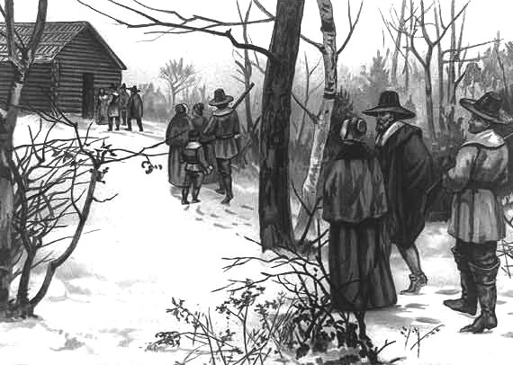
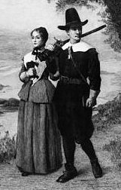

Slide 19
What was the society like?
Rights: Individuals could only have privileges. Rights belonged to institutions and governments -- and chief among them was the right of the institution to do what it must to maintain civil order and see to it that people met their responsibilities.
Education:
Banned: drama, religious music and most poetry.
Encouraged: Bible, Greek classics, some poetry and Latin verse. They were encouraged to create their own poetry, always religious in content.

Slide 20
Free schooling was offered for all children. Reading was emphasized. "Ciphering" (math) and writing were emphasized less
Bible: The Puritans believed that the Bible was God's true law, and that it provided a plan for living.

Slide 22
Spirituality was very important, and everyone would go to long services at the local meetinghouse on Sunday. The Bible would be read at home, and other forms of religious literature were popular, like published sermons, and religious poetry. People would expect to pray at home as well as at church.
The Puritans generally disapproved of many activities, like music, dancing, etc, but people would dance and make merry at weddings, christenings, and other social occasions. People got together for events like barn-raisings and corn-huskings, and women organized spinning and sewing bees. Girls enjoyed berry-picking parties. Ball games were disapproved of, but men were expected to do military training, and this included sports like wrestling and boxing.

Slide 23
Children would be expected to help their parents as soon as they were old enough. They might learn to read and write at home, or they might attend a ‘dame school’ which taught simple reading, writing and arithmetic.
Older boys might go to a grammar school, but many children would leave school early to go to work, either to work in the family farm or business, or to be apprenticed to a trade.
Girls often worked as servants until they married, or they might be apprenticed for a trade: dressmaking, millinery, and some other trades like printing.

Slide 24
Dating?
Parents decided who you would “court” and when. The good news is you might start courting at 14 or 15 – if you were a girl – and might be married at 16.
The bad news? Boys wouldn’t get married until they were done with their apprenticeships and were established in their trade or business – in their mid to late 20’s

Slide 26
Puritans did not view marriage as an occasion for festivities nor as a religious or sacred union. A marriage served strictly as a civil contract and was conducted in a simple civil ceremony that ended in a quiet dinner.
Marriage was preceded by a supervised period of courting that included rather strange practices.
For example, the couple was often given a long tube called a courting stick. The man and woman would whisper to each other through the tube while the rest of the family was in another room.

Slide 27
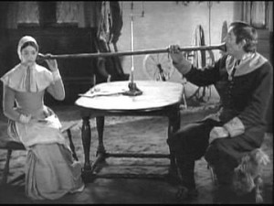

Slide 28
Another unusual custom was "bundling." The couple would share a bed for the night, but with a large wooden board, called a bundling board, separating their bodies and preventing any physical contact.

Slide 30
When the couple was ready to get married, they were required to subject their proposal of marriage to the scrutiny of Puritan leaders, who would either object or approve of their union.

Slide 32
The most prestigious occupation for men was minister or doctor
The most prestigious “occupation” for girls was housewife or midwife

Slide 33
Puritan Teens?
Given great responsibilities.
Given great freedom.
Moved from childhood to adulthood w/o much or any adolescence.

