Slide 1
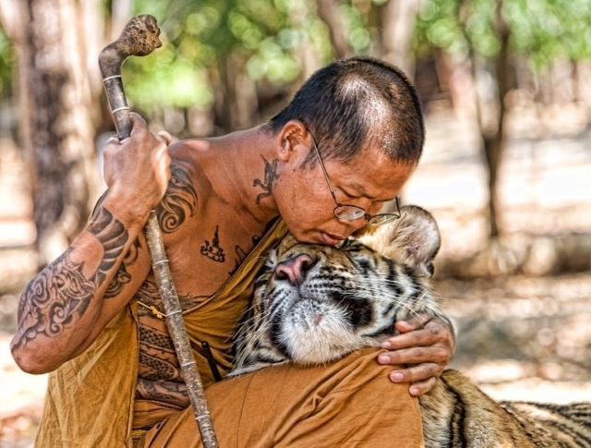
Introduction to
Environmental Science
In every deliberation, we must consider our impact on the next seven generations.
- The Iroqouis Confederacy

Slide 2
Instructor Resources
This slide does not appear while presenting
Fillable student notes outline:
http://www.aurumscience.com/environmental/1_introduction/notes_outline.html
Study guide:
http://www.aurumscience.com/environmental/1_introduction/studyguide.html
Other worksheets and assignments:
http://www.aurumscience.com/environmental/1_introduction/index.html
Next Unit: Principles of Science
http://www.aurumscience.com/environmental/2_science/index.html
Written by James Dauray

Slide 3
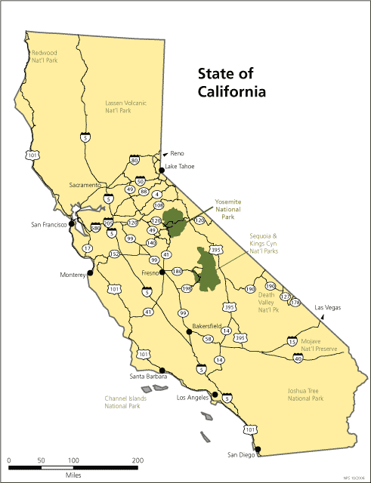
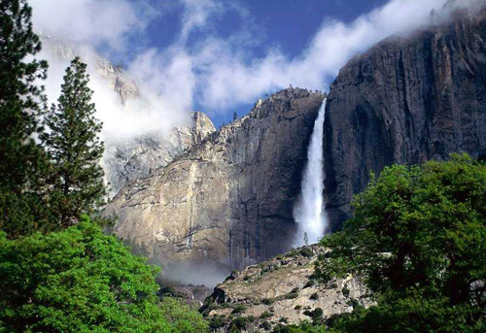
Yosemite National Park
Yosemite National Park is a national park directly east of San Francisco that was created in 1890.
Source: http://www.nps.gov

Slide 4
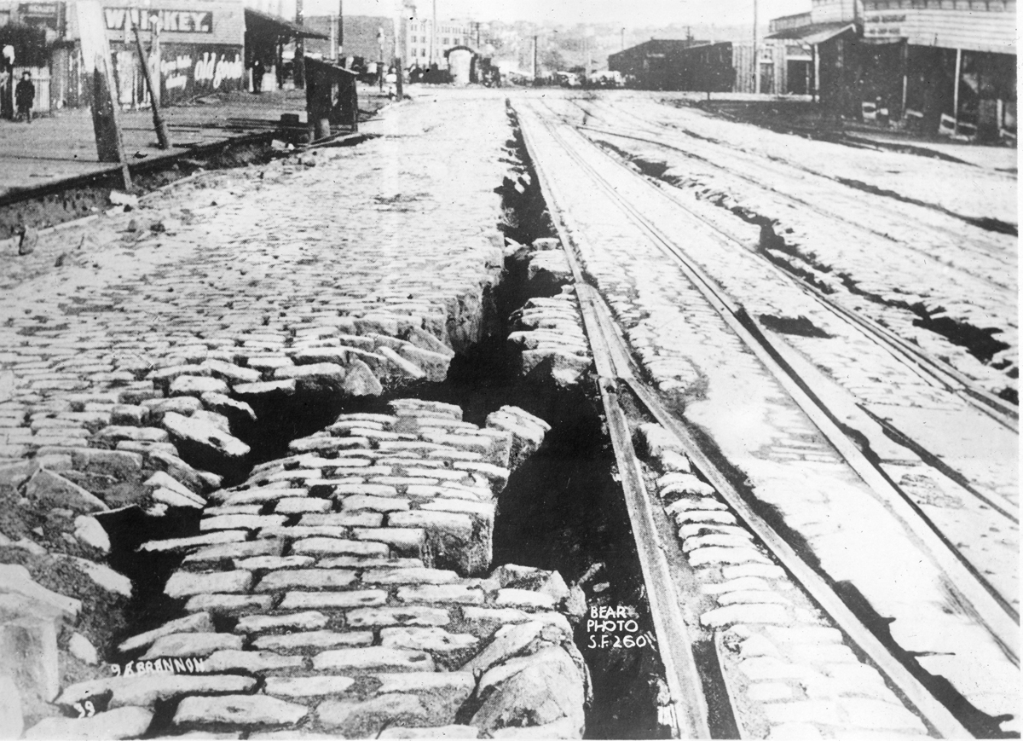
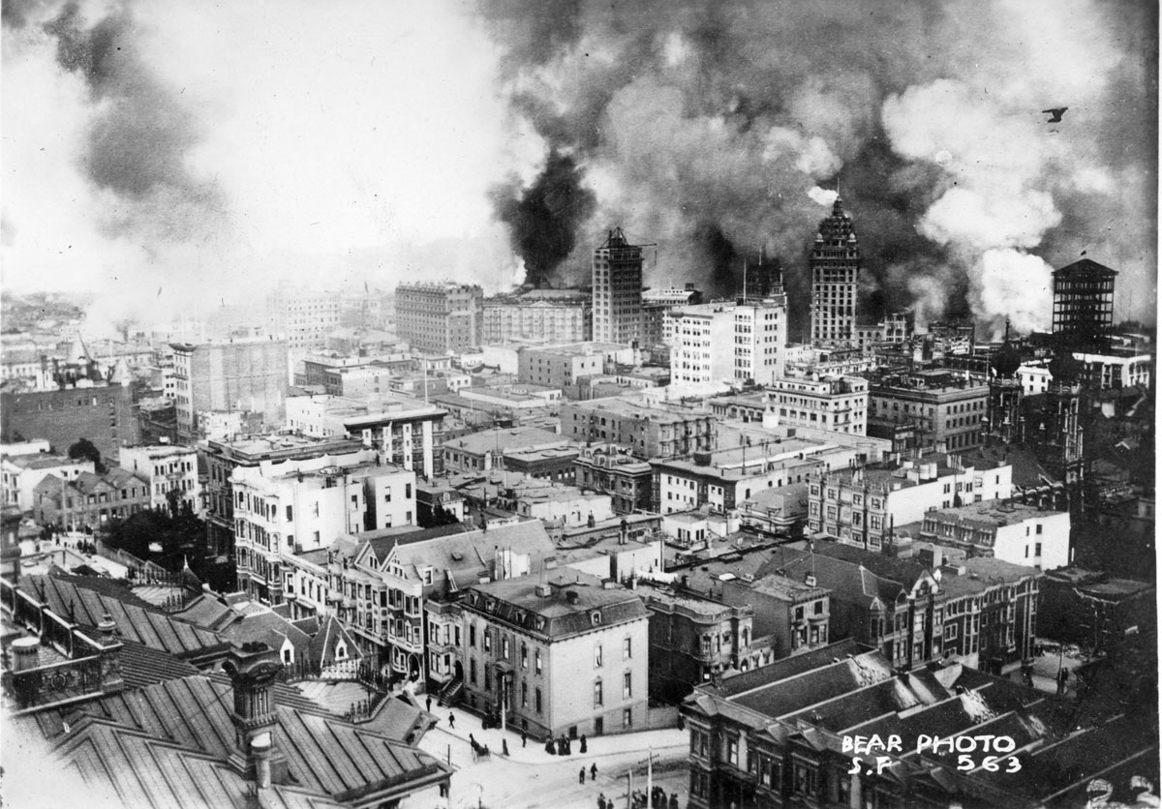
San Francisco Earthquake
The city of San Francisco experienced a tremendous population boom in the 19th century due to the gold rush.
A powerful earthquake struck the city in 1906, followed by a devastating fire.
The city’s water pipes were so damaged by the earthquake, that firefighters were not able to tap fire hydrants.
Source: California State Library

Slide 5
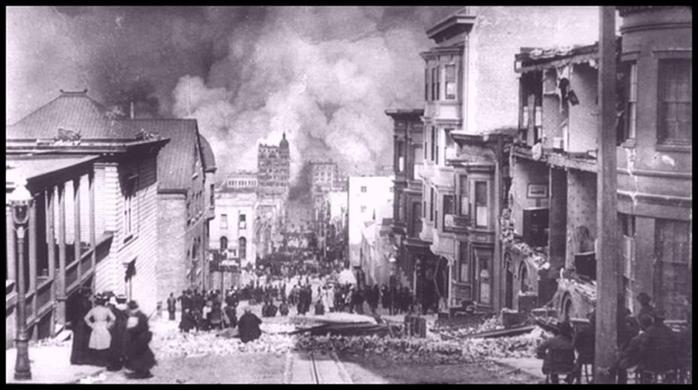
Earthquake of 1906
As the city rebuilt, planners began looking for ways to address some of the issues with the city’s infrastructure, including the water supply.

Slide 6
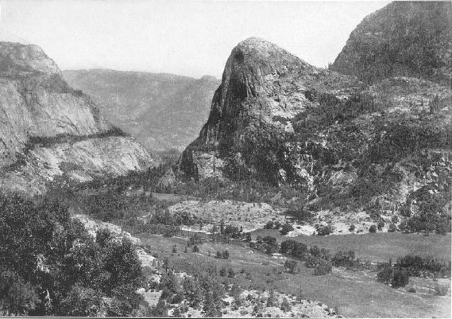
Hetch Hetchy Valley
Source: http://sierranevadaphotos.com
The city applied to the federal government to construct a reservoir in the Hetch Hetchy valley of Yosemite National Park.
An act of Congress and President Woodrow Wilson’s approval were needed for the dam and reservoir to be constructed.

Slide 7
Environmental Science
Environmental science is the study of the interaction of humans with the natural environment.
The environment includes all conditions that surround living organisms:
  Climate
  Air and water quality
  Soil and landforms
  Presence of other living organisms

Slide 8
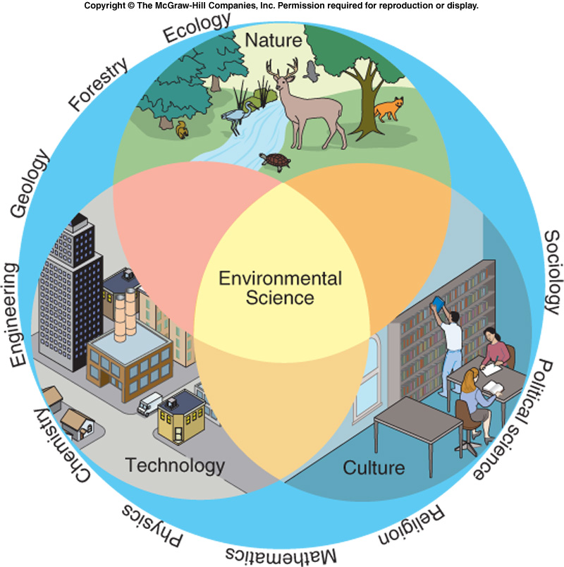
Environmental Science Cont’d
Environmental science and the issues that it studies are complex and interdisciplinary.
  Includes concepts and ideas from multiple fields of study.
  Decisions have impacts in all these fields of study.
Source: Principles of Environmental Science, Cunningham, 2005.

Slide 9
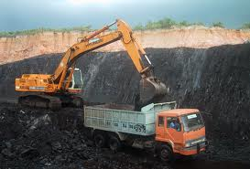
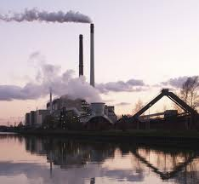
  A community decides to use coal for electricity, as it is the cheapest source available. (Economics)
  The coal must be mined from under the soil. (Geology)
  The coal must be transported to the population center by road or rail. (Engineering)
  When it is burned at a power plant, air pollution is released. Some of that pollution is converted to acid in the atmosphere. (Chemistry)
  This falls as acid rain somewhere downwind. (Meteorology)
  The acid stresses plants by affecting their nutrient absorption. (Ecology)
  Laws are passed requiring the plant to install pollution scrubbers. (Politics)

Slide 10
Major Environmental Problems
Resource Depletion
  A great deal of resources are needed to support the human population (~7 billion).
  Renewable resources can be replenished within a human lifetime.
    Timber, water.
  The supply of nonrenewable resources is replenished extremely slowly, if at all. These can be used up.
    Coal, oil, minerals.

Slide 11
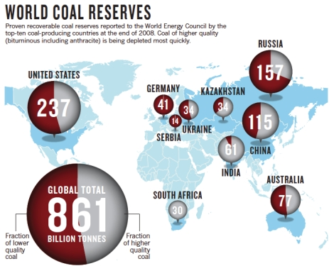
Coal is a nonrenewable resource. Over time, it will become more difficult and expensive to extract.
This graph represents world coal reserves as of 2008. It is estimated we have about 250 years of the resource remaining at current rates of use.

Slide 12
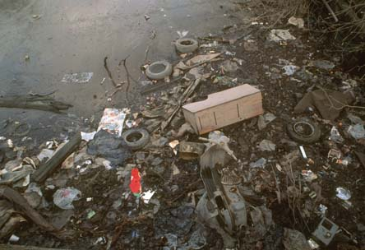
Major Environmental Problems
Pollution
  Pollution is a degradation or an undesired change in air, water, or soil that affects the health of living things.
  Biodegradable pollution will break down naturally over time.
  Nondegradable pollution does not break down.

Slide 13
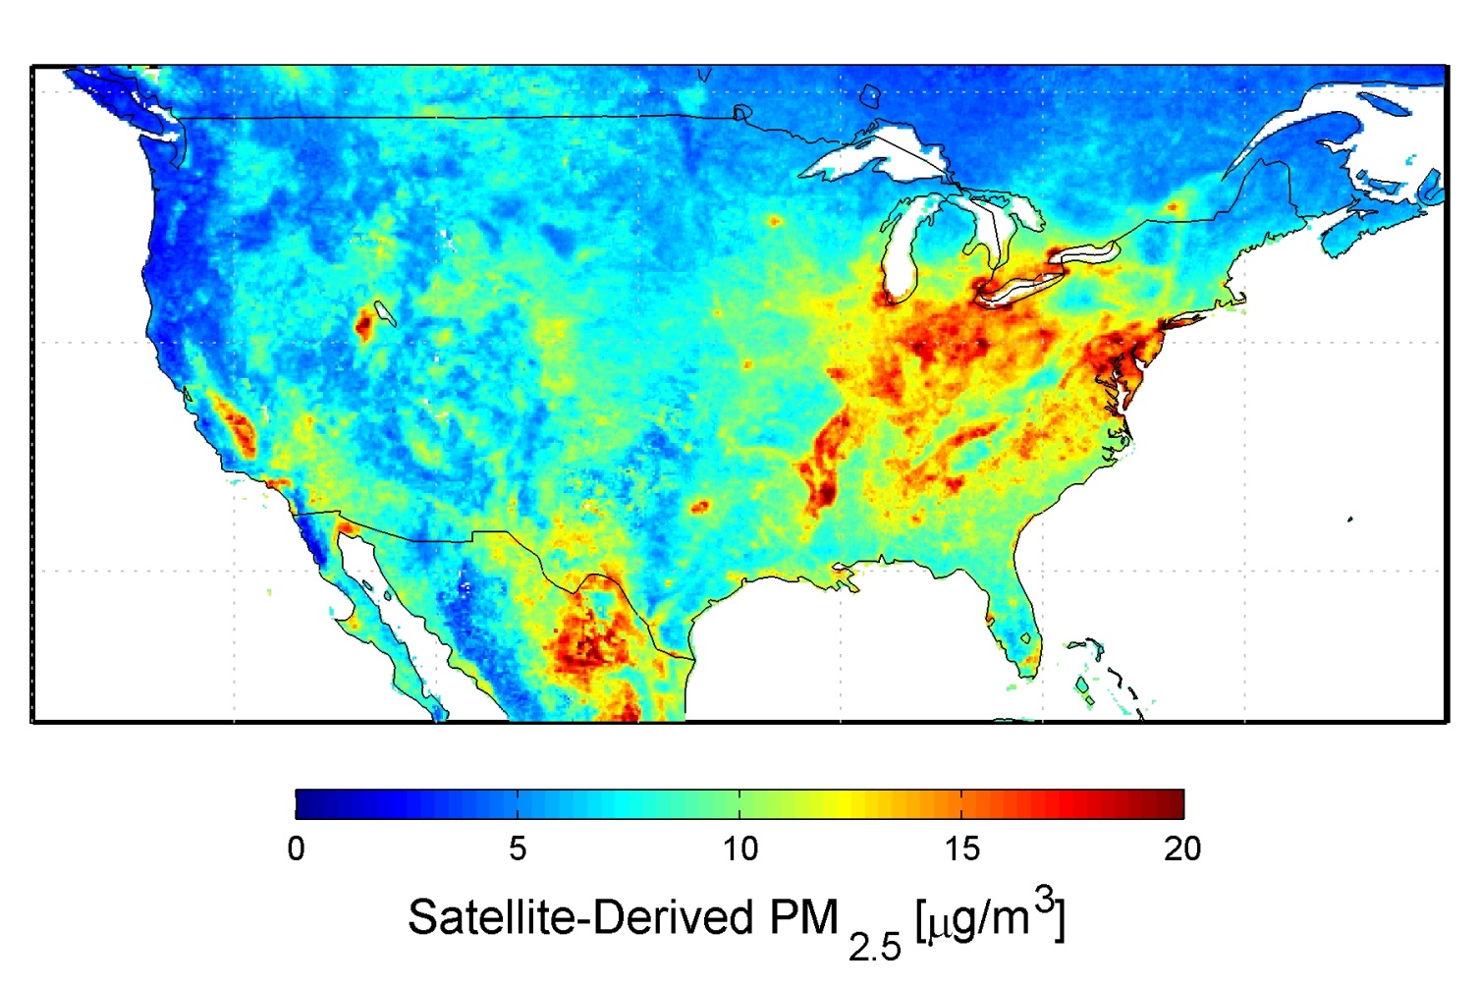
Pollution, whether in air or water, can move and affect ecosystems far away from the source.
This map shows the areas with the highest concentrations of air pollution.

Slide 14
Major Environmental Problems
Loss of Biodiversity
  The number of species on the Earth is unknown, but estimated to be in the tens of millions.
  Biodiversity is the number of different species present in one specific ecosystem.
  Extinction, or the complete loss of a species, is a natural event that can be accelerated by human actions.

Slide 15
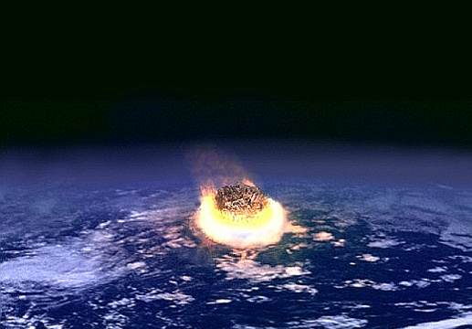
Loss of Biodiversity
There are five known major extinction events in Earth’s history.
The most recent major extinction, about 65 million years ago, caused 75% of all species to disappear from the Earth.
  Believed to have been caused by a meteor impact.

Slide 16
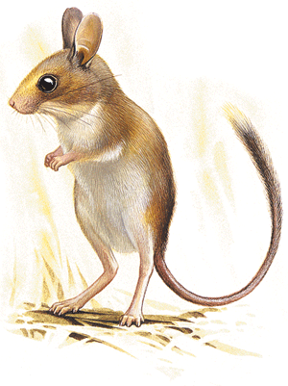
Loss of Biodiversity
Assuming no catastrophic events occur, extinctions normally occur at a pretty slow rate, called the background rate.
  Normal background extinction rate for mammals is 1 every 200 years.
Scientists believe we may be in the midst of the next major extinction event, due to human influences.
Australia has experienced 27 mammal extinctions since 1788, primarily due to the influence of European settlers.
The short-tailed hopping mouse, now extinct in Australia.

Slide 17
Environmental Ethics
Environmental ethics is the discipline that studies the moral relationship of human beings to the environment.
  What is the value of the environment?
  What moral responsibility do we have in dealing with the major environmental problems that result from our resource consumption?
  Which needs should be given the highest priority in our decision making?
Two main categories of ethics have emerged in human culture in modern history.

Slide 18
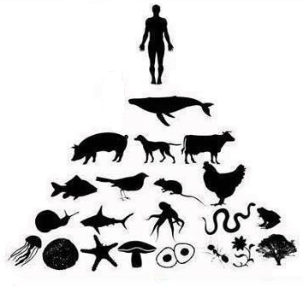
Anthropocentrism literally means “human-centered”.
  This set of ethics protects and promotes of human interests or well-being at the expense of all other factors.
  Often places an emphasis on short-term benefits while disregarding long-term consequences.

Slide 19
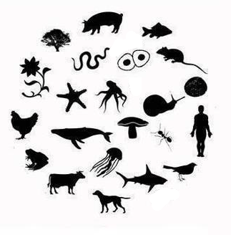
Ecocentrists believe that nature deserves to exist for its own sake regardless of degree of usefulness to humans.
  The preservation of ecosystems or other living things takes priority over human needs.

Slide 20
Hetch Hetchy Debate
The debate about whether to build a dam in the Hetch Hetchy valley was one of the first big debates between these two philosophies.
Anthropocentrists argued that San Francisco needed the water, and this was by far the most viable option.
Ecocentrists argued that this violated the very purpose of the Federal Parks were to be preserved ecosystems – untouched by human hands.

Slide 21
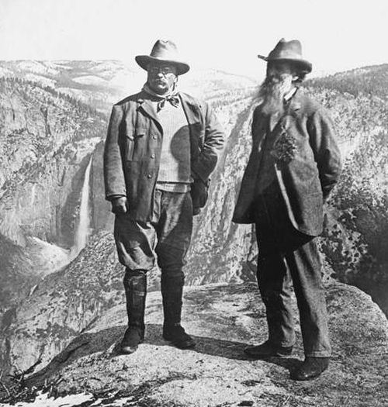
The dam was eventually constructed.
The justification for building it was best stated by Gifford Pinochet, the first man in charge of the U.S. Forest Service.
"Where conflicting interests must be reconciled, the question shall always be answered from the standpoint of the greatest good of the greatest number in the long run.“
This philosophy, called resource conservationism, was also advocated by Teddy Roosevelt.

Slide 22
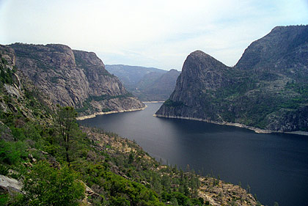
Before and After

Slide 23
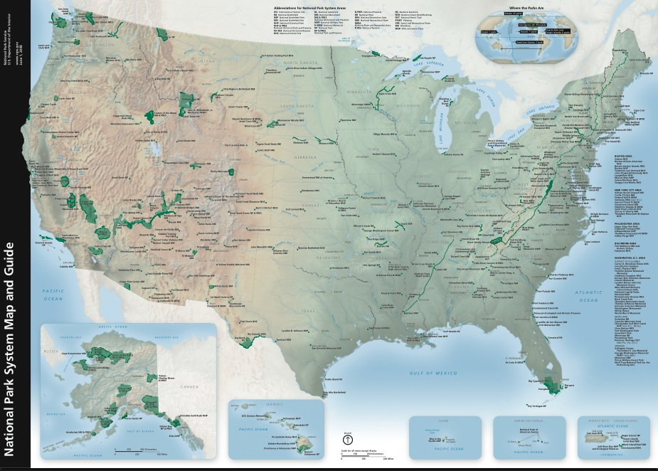
Resource Conservationists
The focus of the resource conservationists was to protect open land.
The National Parks system, and the National Forest system were both created during this time.

Slide 24
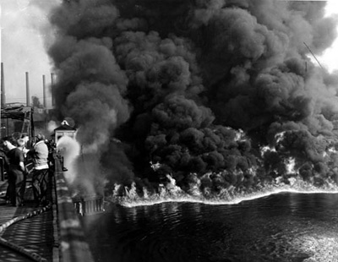
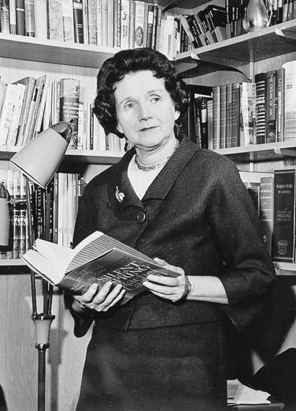
Modern Environmentalism
In 1952, the Cuyahoga river in Ohio caught fire due to all the pollution that had accumulated in it.
Rachel Carson published a book in 1962 entitled Silent Spring about the effects of pesticides on large predatory birds, particularly the bald eagle.
  This began a public awakening to threats of pollution and toxic chemicals to humans as well as other species.
  This movement is called Modern Environmentalism.

Slide 25
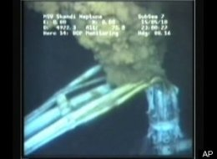
Global Environmentalism
Increased travel and communication enables people to know about daily events in places unknown in previous generations.
  Global environmentalism explores issues and problems over the entire world, not just within the local community.
Live streaming footage of the Deepwater Horizon oil spill in 2010 was watched worldwide.

Slide 26
The Tragedy of the Commons
A great deal of progress has been made since the birth of modern environmentalism, but many debates still rage on.
An ecologist named Garrett Hardin wrote an essay called “The Tragedy of the Commons”, describing the source of environmental problems as a conflict:
  Short-term interests of individuals
  versus…
  Long-term interests of civilization and the Earth itself

Slide 27

A small village consists mostly of farmers that raise and sell sheep at a nearby city.
The only place for the sheep to graze is a commons in the center of the village.
  A commons is an area that belongs to no individual; it is shared by the entire society.
Likely outcome: Villagers obtain as many sheep as possible, allow to graze in the commons.
  Maximize short-term financial gain.

Slide 28

What if the commons was instead divided into sections that was owned by each villager?
  Because the land is owned, individuals are much more likely to plan and use it for the long-term.

Slide 29
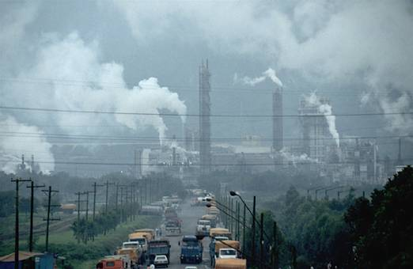
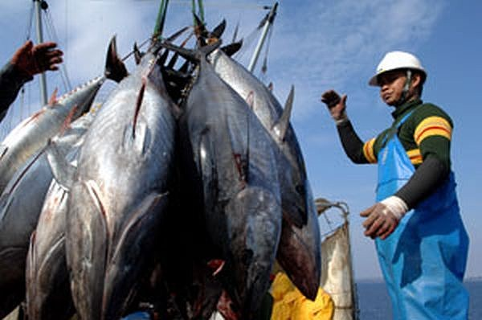
The Tragedy of the Commons describes the likeliness of a commons area being exploited for short-term economic gain.
Modern examples include the atmosphere and oceans.
Zadar, Croatia
Source: Agence France-Presse
Norilsk, Russia
Source: ecojunk.wordpress.com

Slide 30
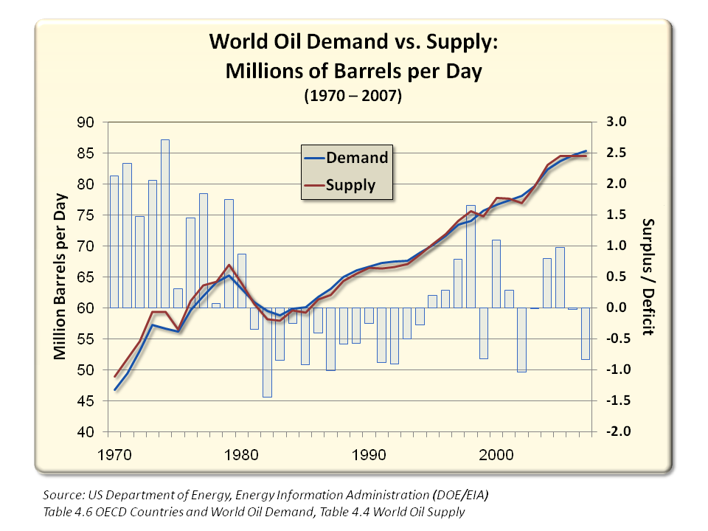
Economics and the Environment
Economics has a huge influence in environmental decision-making.
One of the most basic principles of economics is supply and demand.
  The greater the demand for a limited resource, the higher the price.

Slide 31
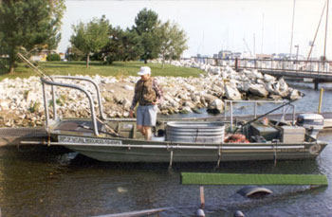
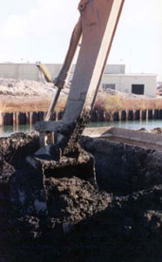
Another important economic idea is the cost/benefit analysis. This questions whether the benefit of doing something justifies the economic cost.
  Waukegan Harbor cleanup efforts, starting in 2010, will cost over $30 million.
Dredging the bottom to remove accumulated pollution.
Monitoring of fish, water, and sediment.

Slide 32
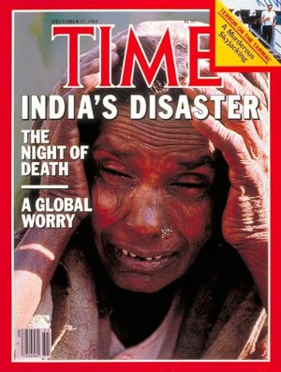
Case Study: Bhopal Pesticide Plant
In December of 1984, a pesticide factory located near the town of Bhopal, India leaked a large amount of toxic chemicals into the air.
The chemicals resulted in an immediate death toll of about 3,000 people, with 8,000 more dying of long-term health ailments.
  A total of 558,125 injuries were reported to the Indian government.
  A settlement of $470 million was reached by Union Carbide and the Indian government.

Slide 33


Ethics and Economics
The settlement was not sufficient to treat all of the long-term health issues stemming from the disaster.
  The site itself was also not remediated.
In 1999, Union Carbide was purchased by Dow Chemical.
To properly compensate and treat all individuals affected by this disaster, Dow Chemical would have to pay billions of dollars in settlements.
Dow Chemical has a yearly profit of over $2 billion, with total assets worth nearly $70 billion.

Slide 34

The Yes Men Fix the World. Dir Andy Bichlbaum, Mike Bonanno. Charny/Bacharach Entertainment, 2009.

Slide 35
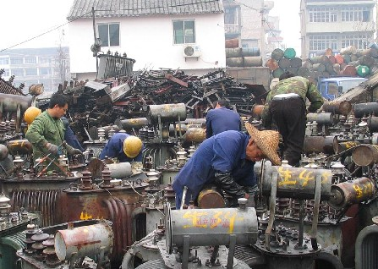
Developed and Developing Countries
One of the factors that led to the Bhopal disaster and lack of cleanup is that at the time, India was a developing country.
  Developing countries have lower incomes, shorter life spans, and rapid population growth.
Developing countries, overpopulated and desperate for economic gain, tend to have less regulations on their industries and fewer environmental protections.

Slide 36
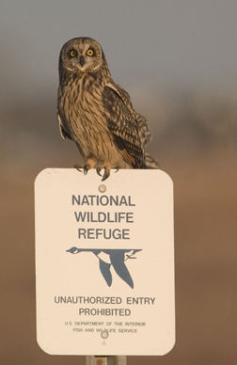
Developed countries on average have higher incomes, longer life spans, and slower growth rate.
These countries are more economically stable, educated, and have more environmental protections.

Slide 37
Population and Consumption
Developed countries, while smaller in size and growth, consume resources at a greater rate.
About 20% of the world’s population uses 75% of its resources.

Slide 38
The Demographic Divide
 | U.S. | Japan | Mexico | Indonesia
Life Expectancy | 77 | 81 | 71.5 | 68
Population Growth Rate | 0.8% | 0.2% | 1.7% | 1.8%
Gross National Product Per Person | $29,240 | $32,350 | $3,840 | $640
Energy Use Per Person (Millions of BTUs) | 351 | 168 | 59 | 18
Carbon Dioxide Produced Annually Per Person | 20.4 | 9.3 | 3.5 | 2.2
Garbage Produced Annually Per Person | 720 | 400 | 300 | 43
Source: Holt Environmental Science, Arms, 2007

Slide 39
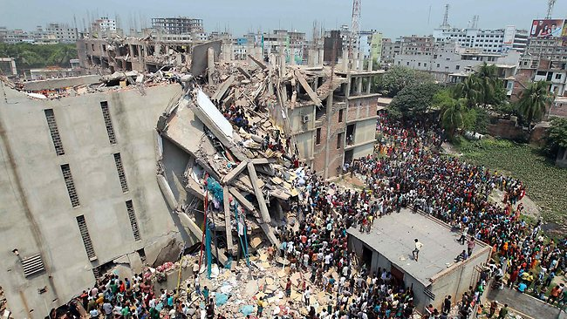
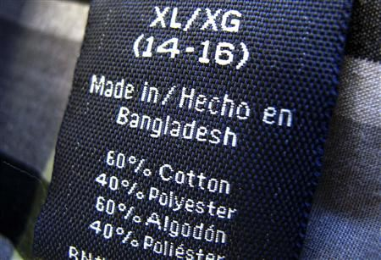
Many products used in developed countries are produced in developing countries.
  Working conditions and pay in these countries is often at levels that would be unacceptable elsewhere.
A collapsed garment factory in Savar, Bangladesh. Source: AP

Slide 40

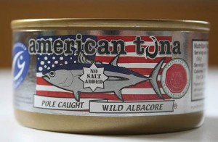
Example
StarKist brand chunk light tuna in water
  Price at Jewel-Osco grocery: $0.99
American Tuna brand wild albacore tuna in water
  Price at Whole Foods market: $4.99
What are the hidden costs behind that $4.00 price difference?

Slide 41
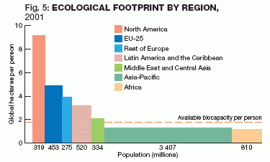
Ecological Footprint
An ecological footprint is one measurement of a person’s resource use.
  Includes the amount of space needed to support each person in a nation, including forests, farms, cities, etc.
Developed countries have a much larger footprint, reflecting a much larger use of resources.

Slide 42
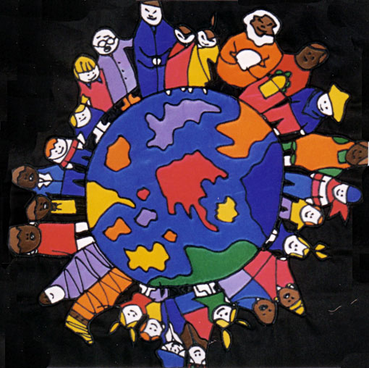
The Goal: A Sustainable World
Sustainability is when human needs are met so that the population can survive indefinitely.
  “Meeting the needs of the
  present without
  compromising the ability of
  future generations to meet
  their own needs.”
    Brundtland Commission, 1987

Slide 43
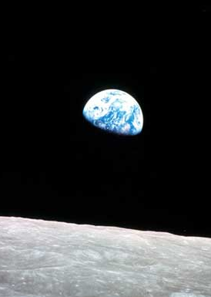
The Spaceship Earth Worldview
The Earth is a closed system, meaning nothing enters or leaves the Earth in large quantities is heat.
  Resources are limited, but the population continues to increase.
  Wastes do not go away.
  “We travel together, passengers on a little ship, dependent on its vulnerable reserves of air and soil.”
- Adlai Stevenson
“Earthrise” taken by Apollo 8 crew, 1968.

