Slide 1
Article III
Today we will learn about the federal judicial branch.`

Slide 2
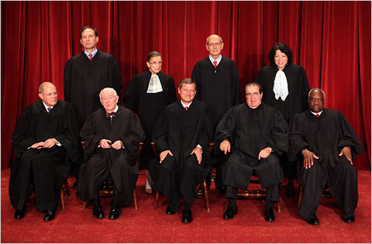
Bellringer – Who are they and how do they get their positions?

Slide 3
Intro
Decision with and without feedback….

Slide 4
Body – Article III
The article deals with the JUDICIAL branch.

Slide 5
Section 1:
The Supreme Court is established in this clause with Congress being given the ability to establish all others. The term for judges was for good behavior meaning lifetime.

Slide 6
The Supreme Court was created in this branch. It assumed the power of JUDICIAL REVIEW in 1803.

Slide 7
Section 2:
Jurisdiction is established in this clause with only two cases being given the status of ORIGINAL JURISDICTION: those cases affecting the AMBASSADORS AND OTHER PUBLIC MINISTERS AND CONSULS and those in which a STATE is a party.

Slide 8
Section 2 continued
All other cases are considered to be appellate jurisdiction meaning:
That they must work their way through the court system through an appeal process.

Slide 9
Section 3
The only crime defined in the Constitution is TREASON – levying war against the US; adhering to the enemies of the US; giving aid or comfort to the enemies of the US.

Slide 10
Closure
New Jersey v. TLO
And
Vernonia School District v. US

Slide 11
Article IV
Section 1 – Establishes that each state must honor the laws, records and courts of the other states.

Slide 12
Section 2
It also establishes the power of extradition meaning:
That if a person flees from a crime in one state, if found in another state, shall be delivered to the state (s)he fled form if demanded by the executive authority of the state.

Slide 13
Section 3
This clause sets the procedure for the admission of new states. This process is given to Congress taking a majority vote for admission.

Slide 14
Section 4
Guarantees to the states: a republican form of government, protection against invasion and domestic violence (by the Legislature or Executive if the legislature cannot be convened)

Slide 15
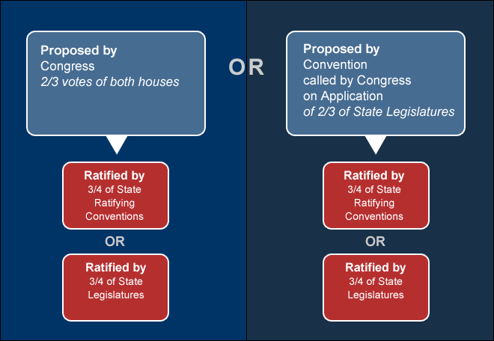
Article V
Makes Provisions for amending this document. This procedure is as follows.

Slide 16
Article VI –“The Supremacy Clause”
Federal supremacy is established by this clause. The Constitution is declared to be the “Supreme Law of the Land.”

Slide 17
Article VII
This established the procedure for ratification. It would take 9 of the 13 to put the Constitution into effect. The first to ratify was Delaware (Dec. 7, 1787). The last to ratify was Rhode Island (May 1790) almost 2 ½ years later.

Slide 18
Closure – Why is DE labeled as such?

