Slide 1
7.1 Industry and Transportation
OBJ
Explain how transportation developments and industrialization affects the nation's economy.

Slide 2
Bellringer - Quiz on Reading
1. What transportation development was federally funded and connected Maryland to the Ohio Valley?
2. What invention of Robert Fulton made upstream travel easier?
3. What NYS transportation development increased the population and power of NY especially NYC?
4. What mode of transportation largely replaced canal development in the 1840s?
5. Name one important contributor (a person) that helped to create the American factory system.

Slide 3
Intro - Discuss the weaknesses revealed by the War of 1812...

Slide 4
http://www.history.com/shows/america-the-story-of-us/videos/building-the-erie-canal#building-the- erie-canal
BODY -
Development
Impact on Economy

Slide 5
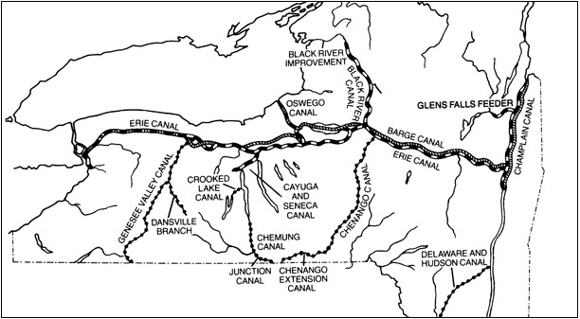
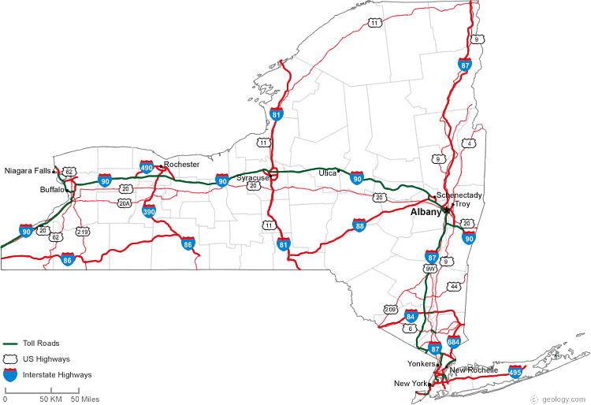
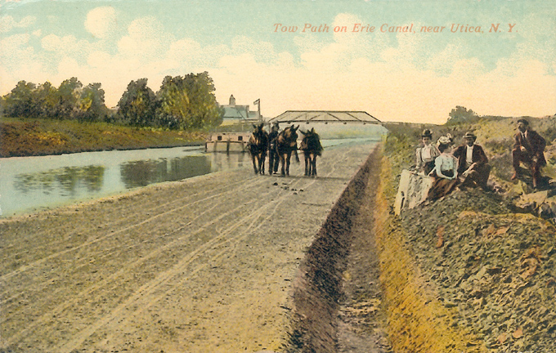

Slide 6
Closure
What impact did interchangeable parts and machines have on American artisans?

