Slide 1
4.3 Objectives:
What factors allowed the Patriots to win the Revolutionary War?

Slide 2
THESE are the times that try men's souls. The summer soldier and the sunshine patriot will, in this crisis, shrink from the service of their country; but he that stands by it now, deserves the love and thanks of man and woman. Tyranny, like hell, is not easily conquered; yet we have this consolation with us, that the harder the conflict, the more glorious the triumph. What we obtain too cheap, we esteem too lightly: it is dearness only that gives every thing its value.

Slide 3
Bellringer - Using the exerpt from Thomas Paine's American Crisis #1 (published on Dec. 23rd, 1776) answer the following questions. ONLY USE THE INFO FROM THE TEXT
1. What will the summer soldier and sunshine patriot do in this time of crisis?
2. What does "he who stands by it now" deserve?
3. What is not easily conquered?
4. What gives everything its value?

Slide 4
Intro:
What were Britain's advantages at the start of the Revolutionary War?

Slide 5
Body: Factors that allowed the Patriots to Win....

Slide 6
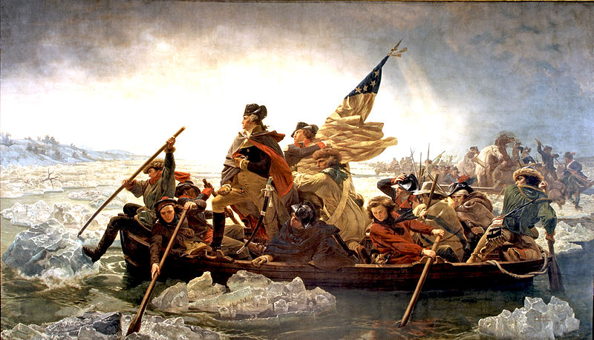

Slide 7
Closure - begin hw = 4.4 (read and take notes using the focus question)

