Slide 1
3.4
Discuss the impact of England's wars on the colonies.

Slide 2
Bellringer Quiz
1. What war was fought over control of the Ohio River Valley?
2. This agreement gave Britain control of Canada, the Great Lakes, the Ohio River Valley and Florida.
3. What tried to prevent the British colonists from settling in the lands west of the Appalachian Mountains?
4. What plan was voted down by the colonies because they felt that they would lose power?
BONUS: This was the name of the Indian leader who was the chief of the Ottawas in Detroit.

Slide 3
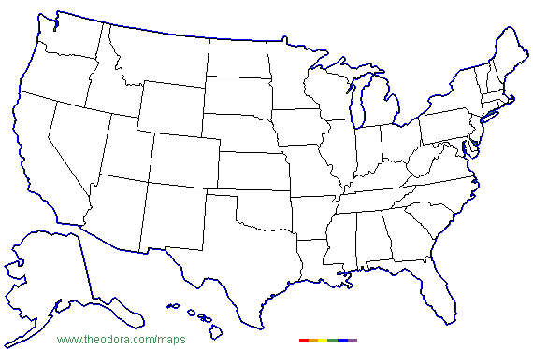
Locate:
St Lawrence River
New England
Great Lakes
Middle Colonies
Southern Colonies
Appalachian Mountains

Slide 4
Body:
Why did the French and British fight in the 1600s and 1700s?

Slide 5
French and Indian War/7 Years War and the impact on the American colonies

Slide 6
Closure:
Why did the colonists oppose the Albany Plan of Union? Why did the British oppose it?

