Slide 1
3.3 Objective
Discuss the economic and social structure of the New England, Middle and Southern colonies.

Slide 2
Bellringer
1. What region had the highest literacy rates?
2. What region had a compact population that was organized into towns and cities?
3. What was the major port city of the Southern colonies?
4. What region was the most ethnically and religiously diverse?

Slide 3
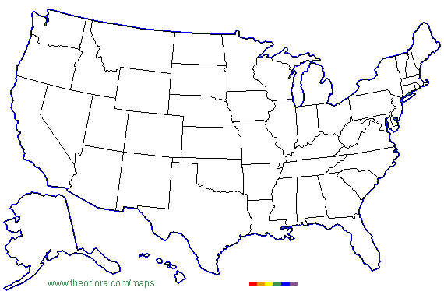
locate the 3 colonial regions
Middle Colonies
Southern Colonies
New England

Slide 4
New England
Middle
Southern
Economic
Social

Slide 5
Closure:
Why did the population of New England increase so rapidly?

