Slide 1
Hoover Fails
OBJS
Discuss Hoover’s beliefs that shaped his response to the Great Depression.
Evaluate the impact of Hoover’s programs on the Great Depression.

Slide 2
Bellringer
Political Cartoon analysis- GM

Slide 3
Copy HW –
Read and outline p. 694-699
Questions
How did Hoover deal with the Great Depression?
What were the effects of the Depression?
How did the spending habits of the 1920s help to cause the Great Depression?
How did Booker T. Washington’s and WEB DuBois’ philosophies differ ?

Slide 4
Compare and Share HW
1. How did the Great Depression affect the
majority of Americans?
2. What was the impact of the Stock Market
Crash?
3. What impact did Henry Ford have on America?
4. 1-5

Slide 5
Intro
George Bush faced similar economic problems as Hoover did (in 1932) in the 1992 election and loss to Clinton.

Slide 6
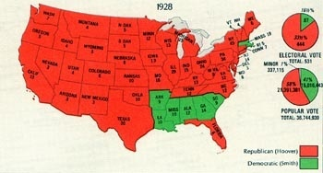

Slide 7
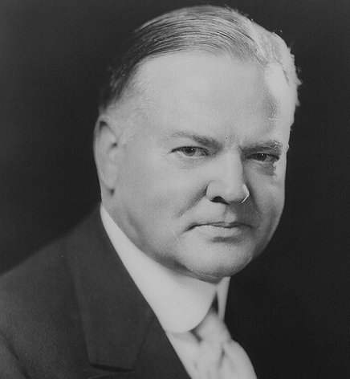
C. Hoover Fails
1. Hoover’s Philosophy
Calls for government RELIEF (food, clothing and shelter) were wrong
RUGGED INDIVIDUALISM – use hard work and character to rise above the situation

Slide 8
Private charities and local communities should provide aid – lacked enough funding
Committee for Unemployment Relief – encouraged more charity - unsuccessful

Slide 9
2. Boosting the Economy
Meeting of Industrial leaders – encouraged them to keep wages and employment the same
Optimism – voice of the government – tried to downplay the negative aspects of the economy

Slide 10
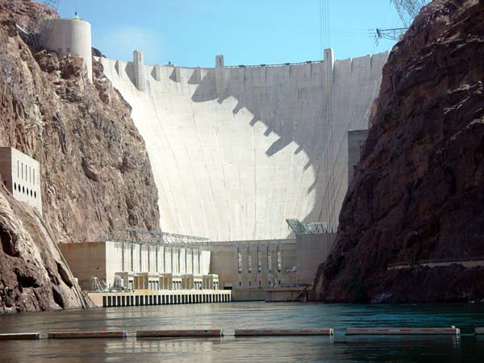
Public Works Projects The Boulder/Hoover Dam

Slide 11
Coping With the Farm Crisis
Agricultural Marketing Act
created the Federal Farm board –
bought surplus crops to increase prices – stores of materials would be sold at a later date
Farmers produced more – idea failed
Home Loan Bank Act – gave $ to banks, building and loan groups to offer low interest loans

Slide 12
The Reconstruction Finance Corporation
Lent large sums of $ to RR, insurance corps, banks and other financial institutions
GOAL =reduce foreclosures and create jobs
Trickle Down approach – not enough $ got to the common man quick enough
“Too Little, Too Late”

Slide 13
Government Activism
Fed. Gov. under Hoover was more involved in the economy than any other previous president
Americans blamed Hoover for their plight

Slide 14
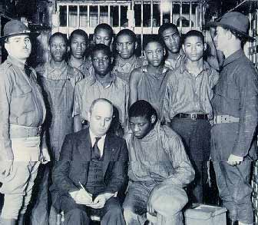
4. Rumblings of Discontent
Communist and Socialist parties grew
Scottsboro boys

Slide 15
Ford Auto plant strike
Bonus Army –
10K vets went to DC to protest for a bonus bill
set up camps
bill rejected
2k stayed and violence broke out/3 killed

Slide 16
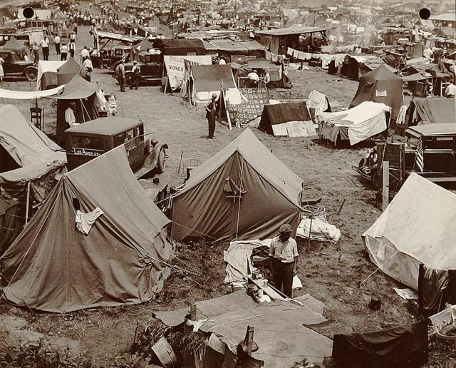

Slide 17
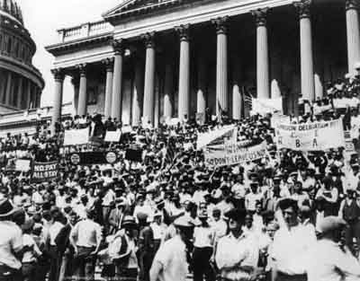

Slide 18
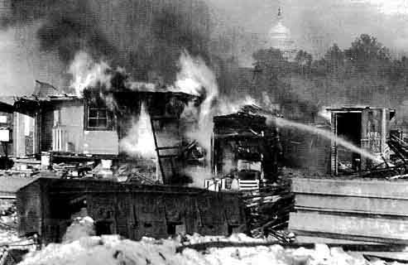

Slide 19
“In Hoover we trusted and now we are busted!”

Slide 20
5. Election of 1932
Dem – FDR – New York Governor who promised a “New Deal” and a fairer distribution of wealth
Rep – Hoover – depression record gave him little chance of victory
Dem’s take Presidency, and majority in both houses of Congress

Slide 21
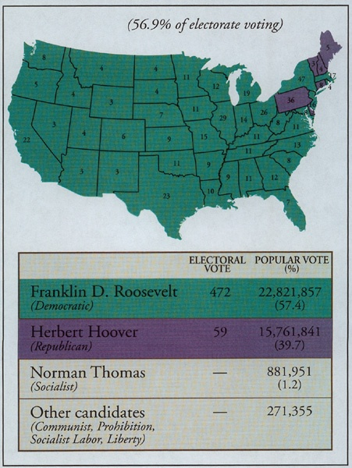

Slide 22
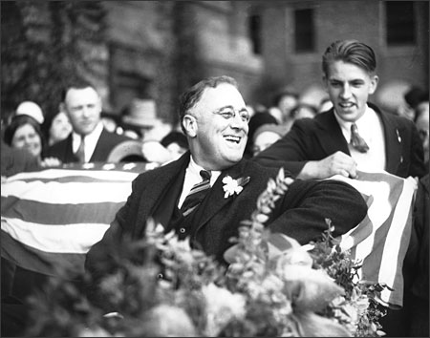

Slide 23
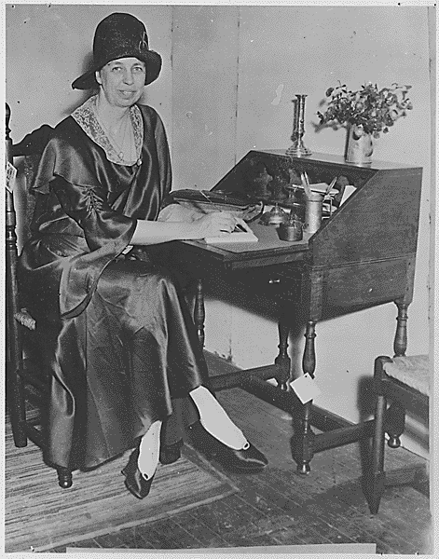

Slide 24
Closure
“Once upon a time my political opponents honored me as possessing the fabulous intellect and economic power by which I created a worldwide depression all by myself!”
Herbert Hoover

