Slide 1
18.1
OBJ - Explain how and why the United States became more imperialistic in the late 1800s.

Slide 2
Bellringer;
1. State one economic reason the US became imperialistic.
2. State one political reason the US became imperialistic.
3. How did the US acquire Alaska?
4. According to this reading, what US territory was annexed by the US even though an investigation revealed that the majority of its peoples opposed annexation?
BONUS: What planter became the leader of Hawaii in 1893?

Slide 3
Intro:
Read the quote on the top of p. 586.
1. What is fully ripe according to John Stevens?
2. What should the US do according to this quote?

Slide 4
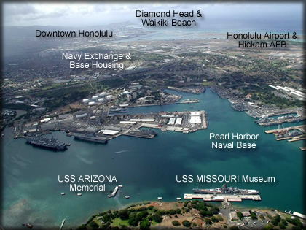
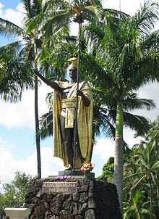
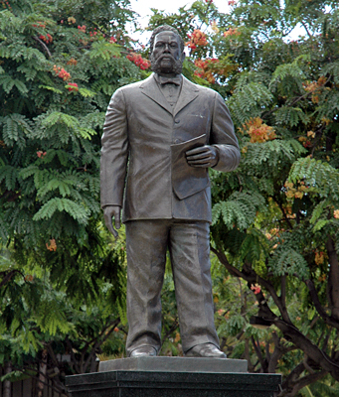

Slide 5
IMPERIALism =
Why did the US become imperialistic?

Slide 6
HOW did the US become imperialistic?

Slide 7
Closure - p. 590 and movie....

