Slide 1
15.3
Objectives:
Explain the changes in city life during the late 1800s.

Slide 2
Bellringer
Define Philanthropy

Slide 3
Copy HW
Read p. 486-490 and take notes on:
What was the Tweed Ring?
What corruption occurred under the Grant Administration? The impacts?
Evaluate the success of the reform movements.
Questions
What were the settlement houses?
What was the Chinese Exclusion Act?
How did Rockefeller and Carnegie eliminate competition?
What is expansionism?

Slide 4
Compare /Share HW
What changes occurred in immigration in the late 1800s?
What fueled the 2nd Industrial Revolution in America?
What organizational methods did businesspeople use to increase their profits in the late 1800s?
What was the Great Compromise?

Slide 5
Intro
You will be placed in a group of at least 3 (one person each from the upper, middle and lower classes). Share the information from your reading with your group.
How were your lives similar?
How were they different?

Slide 6
Intro 2
How are the lifestyles of the upper, middle and lower classes differ today?

Slide 7
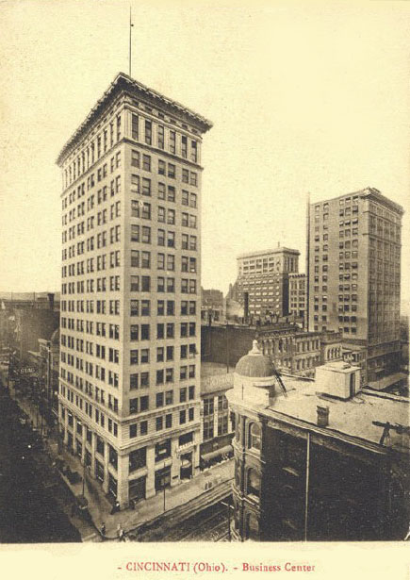
Urban Life
Changes in American cities
a. skyscrapers
b. elevators

Slide 8
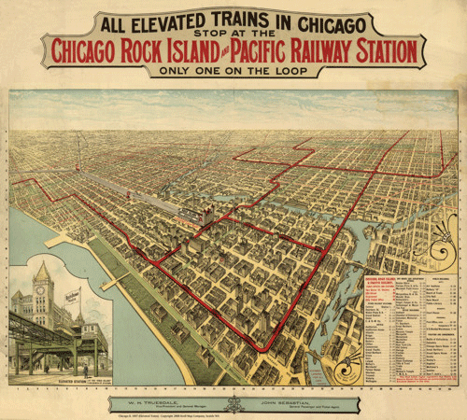
c. mass transit
d. suburbs

Slide 9
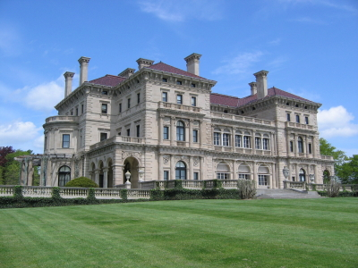
2. City Life
a. Upper Class
1.) conspicuous consumption
2.) philanthropy - charity

Slide 10
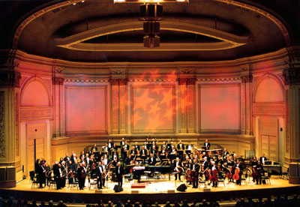
2.) philanthropy – charitable contributions Ex: Carnegie Hall

Slide 11
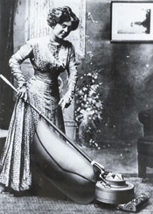
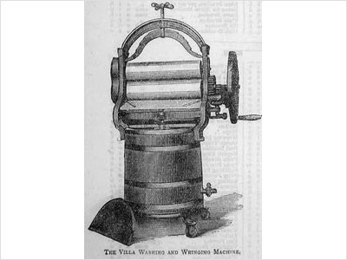
b. The Middle class
1.) more leisure time
2.) women’s lives changed by inventions

Slide 12
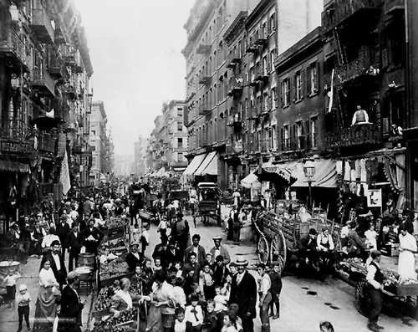
c. Lower Class
1.) tenements
2.) horrible conditions

Slide 13
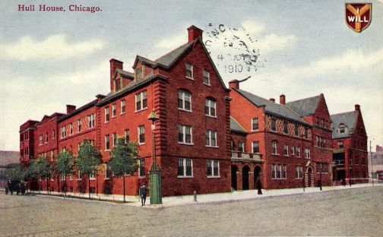
3. Reform
a. settlement houses
1.) Jane Addams (Hull House)
2.) Janie Porter Barnett – Afr. Ams

Slide 14
b. Social Gospel
1.) Washington Gladden
2.) Christian ideals to solve poverty

