Slide 1
12.1 Rival Plans for Reconstruction
Objectives:
1. to state the problems faced at the end of the Civil War.
2. to compare/contrast the Reconstruction plans of Presidents Lincoln, Johnson and Congress.

Slide 2
Intro:
1. Read your assigned reading SILENTLY (401 or 402).
2. List at least one problem stated in the reading.
3. Brainstorm a possible solution.
4. Share with your learning partner.

Slide 3
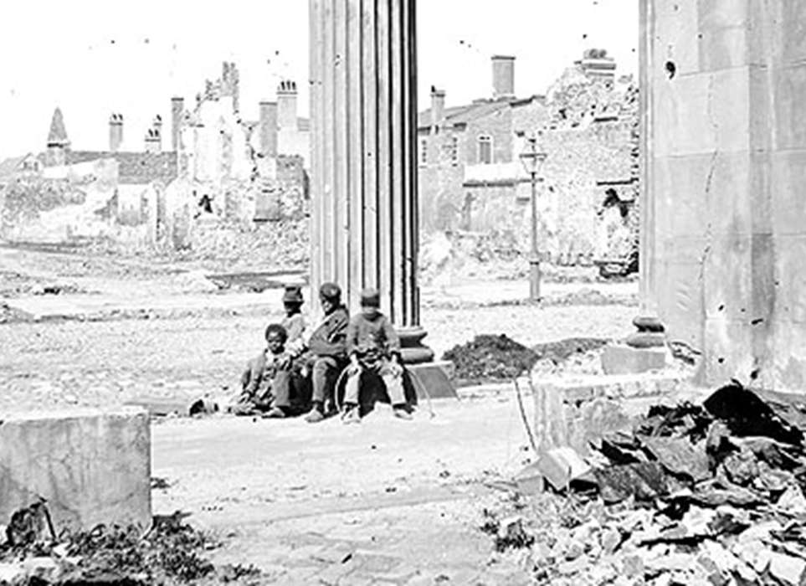
BODY
What were the major issues of Reconstruction/the problems created by the Civil War?

Slide 4
Plans for Reconstruction
Lincoln
Johnson
Congress

Slide 5
Political Change Brought About by Reconstruction:
14th amendment:
15th amendment:

Slide 6
Andrew Johnson's Impeachmet:
Charges:
Outcome:

Slide 7
Closure:
What branch is attempting to gain more power in Reconstruction?

