Slide 1
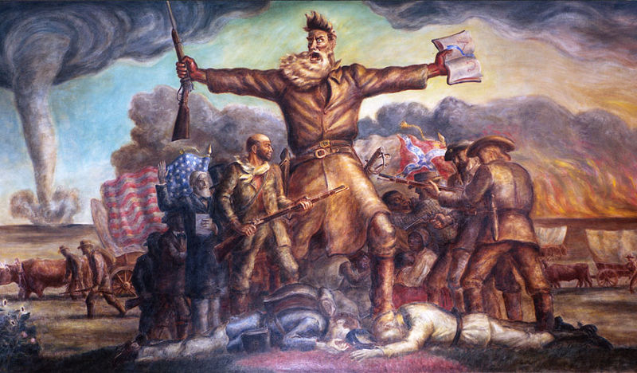
Objectives:

Slide 2
Bellringer:
What was the Missouri Compromise?

Slide 3
Compare and Share HW:
1. How did the Fugitive Slave Act affect public opinion in the North?
2. What were John C. Calhoun’s beliefs regarding federal supremacy and slavery?
3. What impact did the Second Great Awakening have on American history?
4. What are the rights guaranteed in the 10th amendment?

Slide 4
Road to War
6. Dred Scott Decision (1857)
a. Dred Scott - slave
b. owner = Emerson - army surgeon went to the free state of Illinois and free territory of Wisconsin
c. Scott sued for freedom based on residency in free state
d. Chief Justice Taney's decision
1.) Scott not a citizen therefore could not bring case to court
2.) Claim had no merit - Missouri
Compromise unconstitutional based on 5th Amendment - forbids Congress to deny property without due process of law.... slaves = property

Slide 5
Lincoln - Douglas Debates - 1858 - for IL Senate position - sets stage for 1860 Presidential Debates

Slide 6
http://www.history.com/shows/america-the-story-of-us/videos#john-brown
7. John Brown's Raid
a. Harper's Ferry - Federal Arsenal in VA
b. goal = steal weapons - supply slaves for revolt
c. Oct. 18th - Robert E. Lee captures him
d. Dec. 2, 1859 - Brown hanged for murder, conspiracy, etc against VA

Slide 7
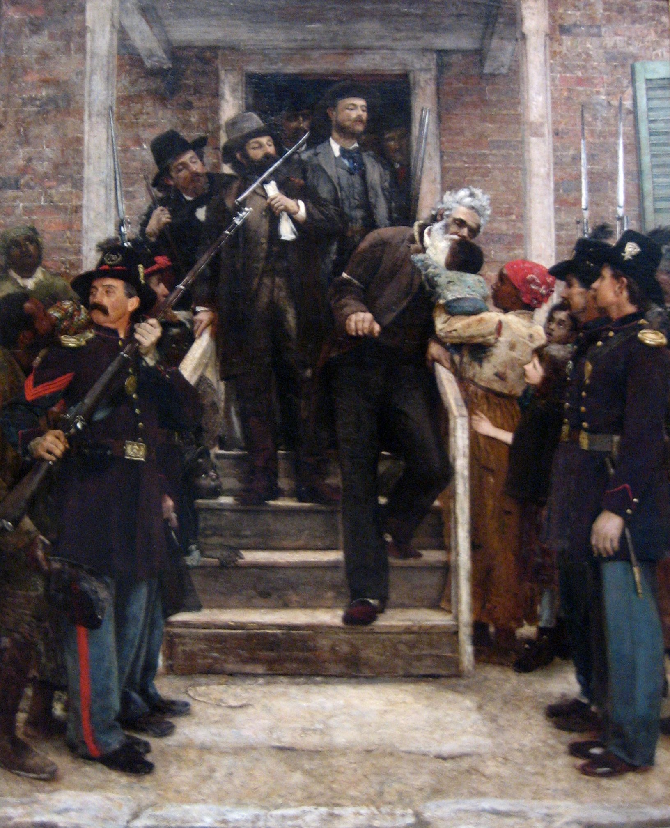

Slide 8
8. Election of Abraham Lincoln (1860)
a. Lincoln - Rep. - winner
b. Douglass - Northern Dem.
c. Breckinridge - Southern Dem.
d. Bell - Constitutional Union

Slide 9
9. Secession of SC (1860)
a. cause - election of Abe Lincoln
b. Southern states formed the Confederate States of America
Mississippi
Florida
Alabama
Georgia
Louisiana
TX
c. Jefferson Davis = Confederate President

Slide 10
Closure - Start HW

